Slide 1
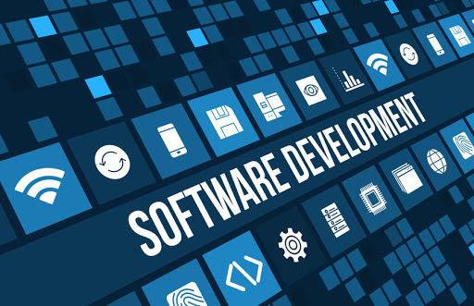
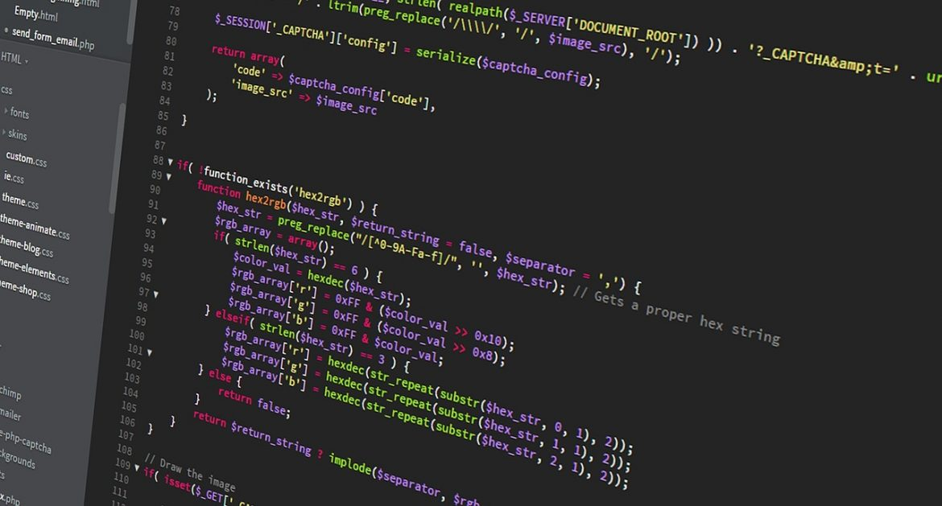
Software Development Concepts
Fundamental Concepts and Paradigms in the Software Engineering Profession
SoftUni Team
Technical Trainers
Software University
https://softuni.bg
Notes:
Hello everyone. Welcome to the "Software Development Concepts" lesson from the "Programming Fundamentals" training course at SoftUni.
I am doctor Svetlin Nakov, senior technical trainer and co-founder of SoftUni and I will teach this lesson.
I will introduce you to the most important fundamental concepts, principles and paradigms of the "software engineering" profession.
I will start with the 4 essential skills of software engineers and will explain how the main concepts of computer science and software development are related to the software engineering profession.
Then, I will briefly present some of the most important concepts and paradigm of software development like object-oriented and functional programming, component-based and event-driven programming, libraries and frameworks, software architectures, front-end and back-end, databases, Web development concepts, operating systems, virtualization and cloud, software development methodologies, quality assurance and others.
I have limited time, so I will only mention most of these concepts without a solid explanation, because it takes years to master them.

Slide 2
Table of Contents
Front-End Development Concepts
Web Front-End and DOM
AJAX and RESTful APIs
Templating Engines
Routing and Routing Libraries
Libraries vs. Frameworks
UI Frameworks
Mobile Apps
2
Notes:
Front-end development concepts and technologies, including the following:
Web front-end, the DOM tree in the Web browser, DOM manipulation and Web front-end frameworks
AJAX (asynchronous HTTP requests), Web services, RESTful APIs and programming interfaces for the Web
Templating engines for generating dynamic content and user interfaces
Routing and routing libraries in the Web development
Libraries versus frameworks: what is the difference and the concept of "inversion of control"
UI frameworks and their role in building the user interface in software systems
Mobile app development technologies: native mobile apps, hybrid mobile apps and browser-based mobile apps

Slide 3
Table of Contents (2)
2. Back-End Development Concepts
Databases and DBMS Systems
ORM Frameworks
The MVC Pattern
Virtualization, Cloud and Containers
Operating Systems and Linux Shell
3. Embedded Systems and IoT
3
Notes:
Back-end development concepts and technologies, including the following:
Databases, relational and non-relational, database management systems (DBMS), and the SQL language
Object-relational mapping frameworks (ORMs) for simplified database access
The Model-View-Controller (MVC) pattern for structuring back-end Web apps
Virtualization technologies, cloud infrastructure, technologies, platforms and services, containers and Docker
Operating systems, processes, task scheduler, file systems, and the Linux shell, shell commands and scripts
Embedded systems, microcontrollers, connected devices and Internet of things (IoT)

Slide 4
Table of Contents (3)
4. Software Engineering Concepts
Software Development Lifecycle
Software Quality Assurance (QA)
Unit Testing
Source Control Systems
Project Trackers and Kanban Boards
4
Notes:
Some important concepts from the software engineering, including the following:
Software development lifecycle: requirements analysis, software design, software implementation, testing, deployment and maintenance
Software quality assurance (QA): bugs and bug trackers, testing (manual and automated), the quality assurance role in software development
Unit testing: principles, patterns and practices and unit testing frameworks
Source control systems: working with a shared source code in a team, version control systems, Git and GitHub
Project trackers, managing the work in a team, and the concepts of "Kanban boards"
All these fundamental concepts and principles are important long-term knowledge, which software engineers gain during their education and experience over the years of their careers.
It takes years to master all of this, but it is a fundamental knowledge, that is slowly changing, and modern software technologies rely heavily on it.
Experienced developers know that once they get a thorough understanding of the main computer science and software development concepts, they can easily learn new technologies and upgrade their technical expertise.
Let's look briefly at these fundamental principles and concepts in the following topics in this lesson.

Slide 5
Have a Question?
sli.do
#fund-common
Notes:
In case you have any question,
feel free to ask in the sli.do platform using the code on the screen,
and the trainers will be happy to answer you very soon.

Slide 6
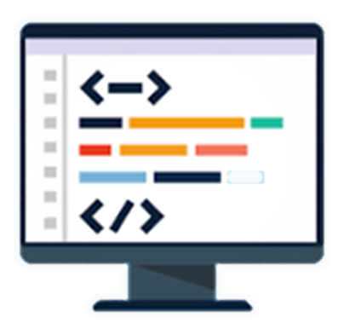
Front-End
Notes:
The front-end is what users see on the screen:
It consists of the client-side app components, the "presentation layer" of the software systems.
The front-end displays the user interface to the users and interacts with them.
Let's review the concepts and principles of modern front-end technologies,
such as the DOM tree in Web browsers,
the REST architecture and RESTful APIs,
AJAX and the concept of asynchronous invocations of back-end services,
the concept of "templating engines" for UI rendering,
the concept of "routing" for URL-based navigation,
and the concept of UI libraries and front-end frameworks.

Slide 7
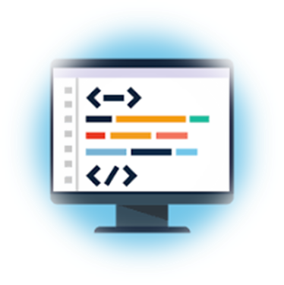
Web Front-End and DOM
Web front-end technologies (see https://platform.html5.org)
HTML, CSS, JavaScript, DOM, AJAX
JS front-end frameworks (e.g. React, Angular, Vue)
DOM (the Document Object Model)
DOM == a tree of UI and other elements
Documents in the Web browser are represented by a DOM tree
The DOM API allows changing the DOM from JS
Notes:
Web front-end, HTML, CSS and JavaScript, together with the Document Object Model (DOM), AJAX and few others
are the dominant technology for building user interfaces for modern software apps.
This set of web front-end technologies is known under the name "HTML5 platform" or "The Web Platform".
See https://platform.html5.org for more details about the HTML5 platform.
It consists of lots of technologies, APIs and standards, implemented in the modern Web browsers.
It is very important for every modern software engineer to be familiar with these HTML5 technologies and the concepts behind them.
Web front-end technologies are the way developers build the user interface, displayed in Web pages, Web sites, Web apps and cross-platform apps.
The HTML and CSS languages describe documents, content, layout, formatting and everything we see on the screen in the Web browser.
JavaScript (which is called also ECMAScript) is the main language, used by developers to program user interfaces in a Web browser.
The DOM technology allows accessing the elements in a Web page through JavaScript.
The AJAX technology allows invoking back-end services from JavaScript front-end apps.
JS front-end frameworks (such as React, Angular and Vue) simplify the Web front-end development by providing structure, components, guidelines and patterns to build maintainable front-end apps.
DOM (the Document Object Model) defines the structure of Web pages.
Documents in the Web browser are represented by a DOM tree.
The DOM tree holds a hierarchy of UI and other elements.
DOM uses composition: most elements could hold other elements within themselves.
This way the elements are organized in a tree (the DOM tree).
The DOM API allows changing the DOM from JavaScript code
and this is how modern Web sites and apps build interactive user interfaces.
Modern Web front-end apps manipulate the DOM tree directly from JavaScript or through a front-end framework and consume data from the back-end.

Slide 8
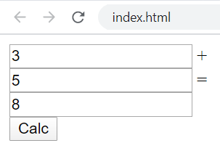
Using the DOM API – Example
<input type="text" id="firstNum" /> +
<input type="text" id="secondNum" /> =
<input type="text" id="sum" />
<button id="calc">Calc</button>
<script>
document.getElementById("calc").onclick = function() {
document.getElementById("sum").value =
Number(document.getElementById("firstNum").value) +
Number(document.getElementById("secondNum").value);
}
</script>
Notes:
This is a simple example of the DOM API.
We want to build a Web page, which calculates the sum of two numbers.
This is how it looks like: 3 text fields and a button.
The numbers are entered in the first two text fields.
When the [Calculate] button is clicked, the third field displays the sum of the numbers from first two fields.
We create a JavaScript code snippet in the Web page to handle the "button click" event.
We find the button element in the DOM tree by its ID and assign an event handler function to its "onclick" property.
When the button is clicked, we use the DOM API to take the text content from the fields,
then we parse the field values into numbers,
calculate their sum,
and display the sum into the last field.
We use the DOM API function "document.getElementById" and the DOM properties "onclick" and "value" to access the fields and the button from the DOM tree, representing the elements at the Web page.
I am not going to explain this in more detail, since here I want to show you a concept (the DOM tree), not to teach you in HTML, DOM, JavaScript and Web front-end programming.
We shall have a comprehensive Web front-end programming course at SoftUni in the end-to-end learning track for software developers, where we will learn and practice how to manipulate the DOM tree in more detail.

Slide 9
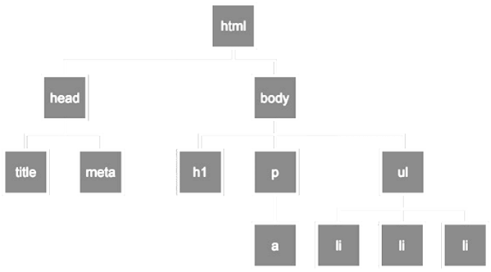
DOM Interaction
Live Demo
https://repl.it/@nakov/summator-js-dom
Notes:
Now it's time to demonstrate you the previous example in action.
I have prepared a live code example at repl.it.
Let' open the link.
It takes some time to load, as usually.
This is the same code from the previous slide.
It takes two numbers and calculates their sum.
Let's run the code.
We enter "5" and "3" and the result is "8", just as expected.
Let's see the DOM tree here.
The DOM tree is this structure.
We have input.
We have another input.
We have another input.
And we have a button.
And these fields have here values assigned in them.
These are the properties of these elements.

Slide 10

AJAX and RESTful APIs
AJAX is a technology for asynchronous execution of HTTP requests from client-side JavaScript
RESTful APIs are HTTP-based Web services
The HTTP methods GET, POST, PUT and DELETE retrieve, create, modify and delete data
let httpRequest = fetch('https://some-url…');
httpRequest.then(function(httpResponse) {
// Process the HTTP response here and update the DOM tree …
});
Notes:
Now' let's talk about an important Web front-end concept and technology: AJAX.
AJAX stands for "Asynchronous JavaScript and XML".
This acronym doesn't describe its nature well, but this is for historical reasons, from the time when XML was popular.
A better description for the AJAX technology is the following:
AJAX is a technology for asynchronous execution of HTTP requests from client-side JavaScript code.
JavaScript front-end apps use AJAX calls to access the back-end services and APIs and consume data from the Web server over the HTTP protocol.
AJAX enables building interactive single page apps, where the content of the page interactively changes, without refreshing the page.
Developers can retrieve data from a URL without having to do a "full page refresh".
This enables a Web page to update just part of a page without disrupting what the user is doing.
This is an example how JavaScript code can download server-side resources over HTTP using the "fetch" function.
The "fetch" function takes as input a server-side resource URL and returns a promise, which will be resolved when the resource is downloaded, or an error occurs.
This code will invoke asynchronously a simple HTTP GET request.
This is an example how front-end connects to the back-end.
The AJAX technology uses the XMLHTTPRequest browser object to asynchronously make HTTP requests.
Typically, when the data is loaded from the back-end, it is rendered in the DOM tree and this way part of the page is updated dynamically.
In most scenarios the AJAX technology is used to consume RESTful APIs from the back-end server.
RESTful APIs are Web services, invoked through the HTTP protocol.
A "Web service" is remote functionality, that can be invoked over Internet.
REST stands for "Representational State Transfer".
It is an architectural concept and industry standard about how to build Web services.
RESTful services typically implements the CRUD operations (create, read, update, delete) over certain data collection.
The HTTP methods GET, POST, PUT, PATCH and DELETE are used to retrieve, create, replace, modify and delete data.
We shall learn more about RESTful services in the front-end and back-end development modules at SoftUni.

Slide 11
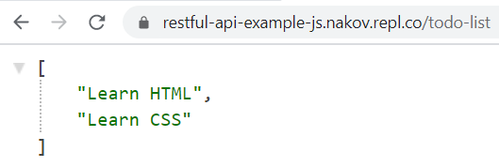
RESTful API Server – Example
const express = require('express');
const app = express();
app.use(require('cors')());
app.use(require('body-parser').json());
let todoList = ['Learn HTML', 'Learn CSS'];
app.get('/todo-list', (req, res) => {
res.json(todoList);
});
app.post('/todo-list', (req, res) => {
todoList.push(req.body.todoText);
res.sendStatus(200);
});
app.listen(8080);

Slide 12
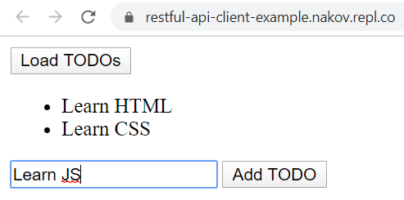
RESTful API Client – Example
<button id="load">Load TODOs</button>
<ul id="todo-list"></ul>
<input type="text" id="todo" />
<button id="add">Add TODO</button>
<script>
const apiUrl = 'https://restful-api-js.nakov.repl.co/todo-list';
document.getElementById("load").onclick = loadTodos;
document.getElementById("add").onclick = addTodo;
async function loadTodos() { … }
async function addTodo() { … }
</script>

Slide 13
RESTful API Client – Example (2)
async function loadTodos() {
let response = await fetch(apiUrl);
let todos = await response.json();
document.getElementById("todo-list").innerHTML = "";
todos.forEach(function(todo) {
let li = document.createElement("li");
li.appendChild(document.createTextNode(todo));
document.getElementById("todo-list").appendChild(li);
});
}

Slide 14
RESTful API Client – Example (3)
async function addTodo() {
let todoText = document.getElementById("todo").value;
let response = await fetch(apiUrl, {
method: 'post',
headers: { 'Content-Type': 'application/json' },
body: JSON.stringify({todoText})
});
loadTodos();
}

Slide 15
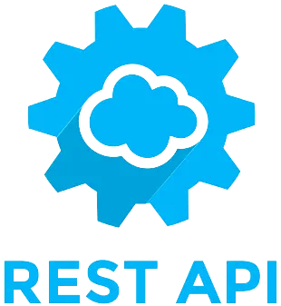
AJAX and REST
Live Demo
https://repl.it/@nakov/RESTful-API-js
https://repl.it/@nakov/RESTful-API-client-example
Notes:
This is a live code demonstration of RESTful Web services.
The example consists of server app (back-end) and client app (front-end).
The back-end is a RESTful service, written in JavaScript with Node.js and Express.js.
It implements a very simple TODO list with only two operations: get all items and add a new item.
You can see the code from the first URL in repl.it.
It needs some time to load.
The RESTful API implements two endpoints:
GET /todo-list, which lists all items,
and POST /todo-list, which creates a new item.
When we run the back-end service, it will show the TODO list as JSON string.
The front-end is a JavaScript single page app.
You can see the code from the second URL in repl.it.
The app consists of Web page (HTML) with embedded JavaScript code.
It holds two functions, bound to buttons on the Web page.
The first button loads the TODO items and displays them in a bullet list in the page.
It uses HTTP GET request to the back-end, which returns the items as JSON object.
Then it uses the DOM API to visualize the retrieved items.
You can play with it when you run the example.
The second button adds a new TODO item and displays the updated list in the page.
It uses HTTP POST request to the back-end.
Please focus on the concepts, not the code and technical details in this example.
It is too early to try to fully understand how this code works.
I just want to show you the concepts of back-end services and front-end apps, which consume these services.
We shall learn how to write RESTful back-end services and how to consume them with AJAX calls during the professional modules at SoftUni.

Slide 16
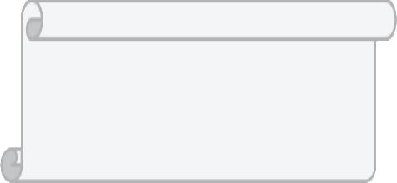
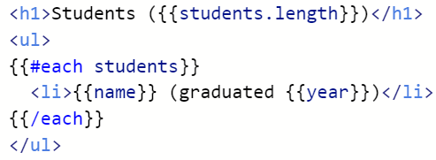

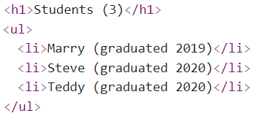
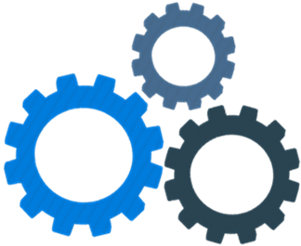

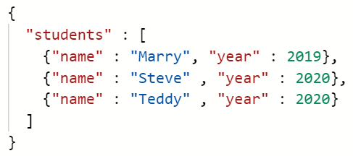

Templating Engines
Templating engines render data as HTML through a template
template
HTML
data
templating
engine
Notes:
The next development concept from both front-end and back-end development is the concept of "templating engines".
Templating engines render data as HTML or other format through a template.
This is very useful, when you want to visualize data, which comes from the server-side or from a database.
The template is written in some templating language like Razor, Handlebars or Pug.
This is how it may look like.
Typically templates combine HTML with special tags.
Templates can render variables, iterate over a collection and perform conditional checks.
For example, we can write a template to render a list of students, as it is shown here.
Data for rendering comes as object, JSON string or other format.
It typically is retrieved from the back-end or from a database.
In this example, a JSON object holds a list of student names and years of graduation.
The rendered output could be HTML or other document.
In our example the output is an HTML list of students.
Templating and templating engines are important concept in programming.
It is part of most Web development frameworks (both front-end and back-end).
It is used to generate documents, reports or print data in certain format.
You will definitely use templating engines in some form, if you work with data and visualization.
We shall learn and practice working with templating engines during the Web front-end and back-end development modules at SoftUni.

Slide 17
Templating Engines Example – Template
Sample template for rendering list of students (using the handlebars engine syntax):
<script id="studentsTpl" type="text/x-handlebars-template">
<h1>Students ({{students.length}})</h1>
<ul>
{{#each students}}
<li>{{name}} (graduated {{year}})</li>
{{/each}}
</ul>
</script>

Slide 18
Templating Engines Example – JSON Data
Sample data for rendering (list of students)
students.json
{
"students" : [
{"name" : "Marry", "year" : 2019},
{"name" : "Steve" , "year" : 2020},
{"name" : "Teddy" , "year" : 2020}
]
}

Slide 19
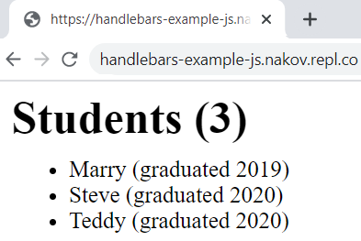
Templating Engines Example – Rendering
Rendering the students using Handlebars templating engine:
<script src="https://cdnjs.cloudflare.com/ajax/libs/handlebars.js/4.7.6/handlebars.min.js"></script>
<script>
async function loadStudents() {
let response = await fetch('students.json');
let students = await response.json();
let studentsTemplate = Handlebars.compile(
document.getElementById("studentsTpl").innerHTML);
document.body.innerHTML = studentsTemplate(students);
}
loadStudents();
</script>

Slide 20
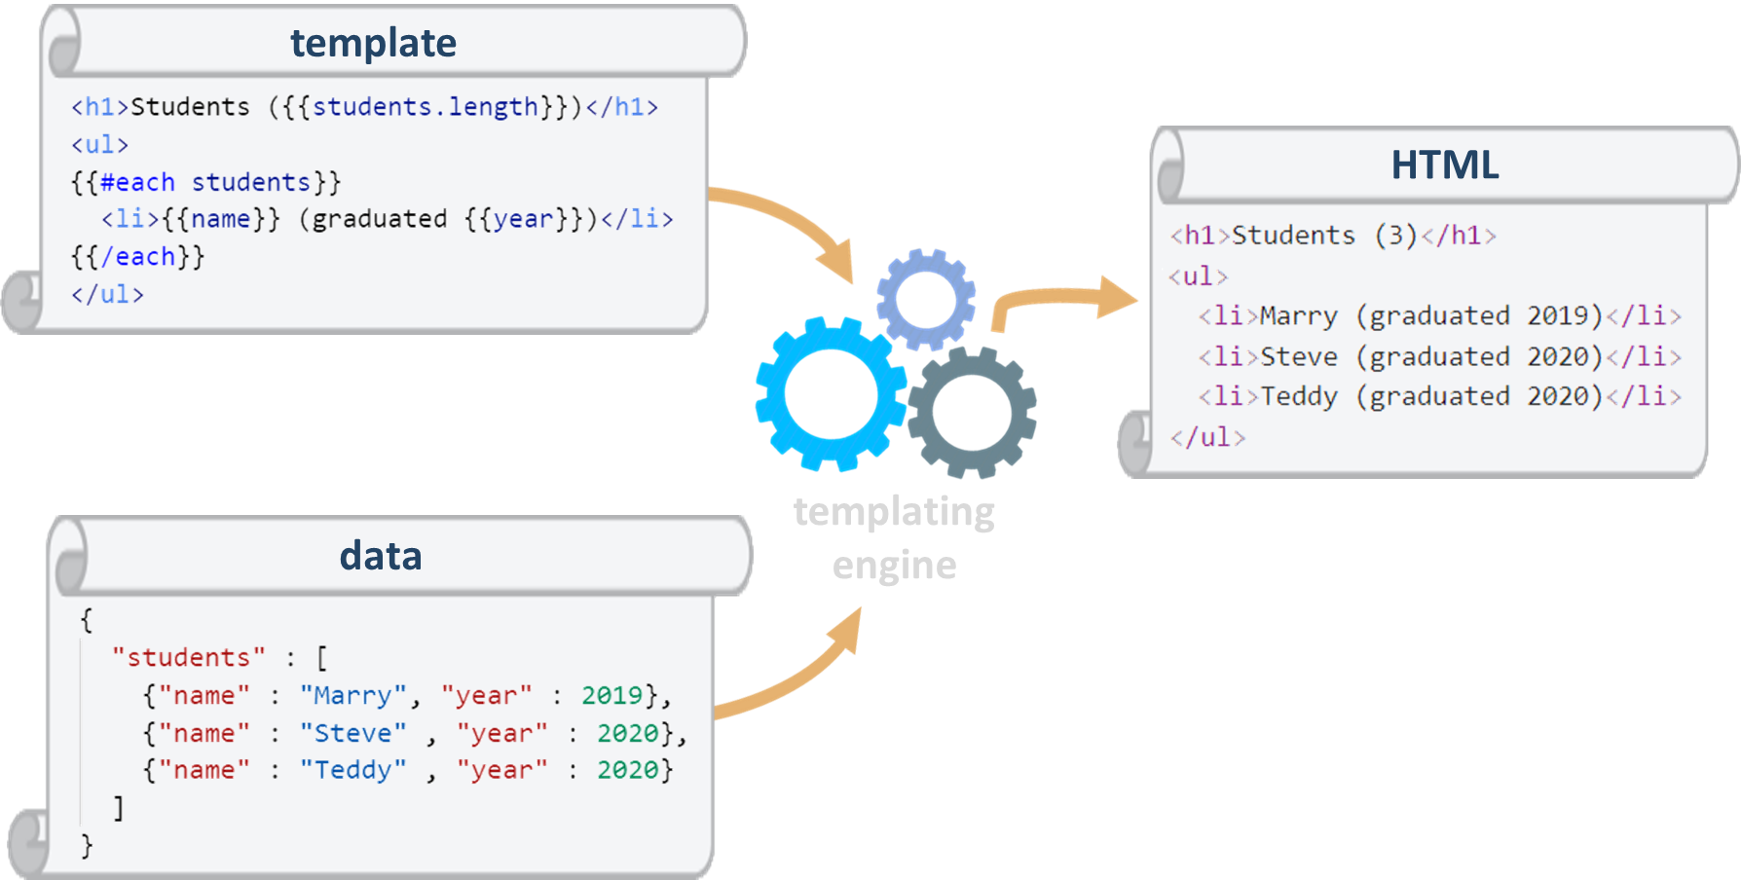
Rendering UI with a Templating Engine
Live Demo
https://repl.it/@nakov/Handlebars-example-JS
Notes:
This is a simple live example of rendering UI with a templating engine.
You can see the code I have prepared in repl.it.
It needs some time to load.
We have two files: index.html and students.json.
The student data come as JSON object from the students.json file.
The main HTML file index.html holds a small snippet of JavaScript code,
which uses the Handlebars templating engine to render the students.
The template is also embedded in the HTML page as snippet.
When we run the code, we see the students, rendered as HTML bullet list.
The technical details about the code are not important here.
Important is the concept of templating engines,
which render data by template as HTML or other format.
This approach is widely used in software development.
You definitely will use it some day if you become a software developer.

Slide 21



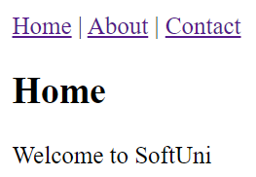
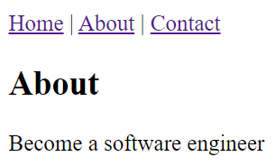
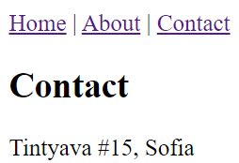
Routing and Routing Libraries
Routing is about switching between different UI views, based on the changes of the current URL (holding the route)
Routing libraries switch the view by URL like this:
Notes:
Another important concept from software development is "routing".
In front-end apps, routing is a technology of switching between different UI views,
based on the changes of the current URL (holding the route).
In back-end apps, routing is a technology of switching between different server-side endpoints,
based on the changes of the requested URL (holding the route).
Many front-end and back-end frameworks internally implement routing and invoke different functionality based on the URL and its components.
Routing libraries switch the view by URL like its is shown below.
This is the "home" URL: /
This is the "about" URL: /about
This is the "contact" URL: /contact
Different routes in the URL switch to different views.
This is the "concept of routing" in Web apps.

Slide 22
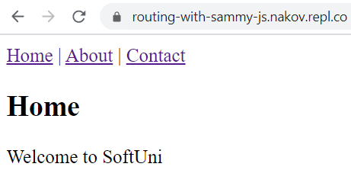
Routing with Sammy.js – Example
Routing with Sammy.js:
$.sammy(function() {
this.get('/', function() {
showView('home');
});
this.get('/#/about', function() {
showView('about');
});
this.get('/#/contact', function() {
showView('contact');
});
}).run();

Slide 23
Routing with Sammy.js – Example
<header>
<a href="/">Home</a> |
<a href="/#/about">About</a> |
<a href="/#/contact">Contact</a>
</header>
<section id='home'><h1>Home</h1>Welcome to SoftUni</section>
<section id='about'><h1>About</h1>Become a software engineer</section>
<section id='contact'><h1>Contact</h1>Tintyava #15, Sofia</section>
<script src="https://unpkg.com/jquery@3.5.0/dist/jquery.js"></script>
<script src="https://unpkg.com/sammy@0.7.6/lib/sammy.js"></script>

Slide 24
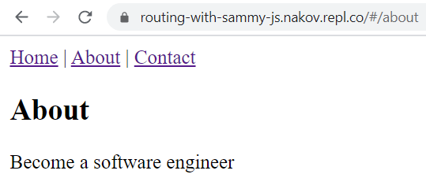
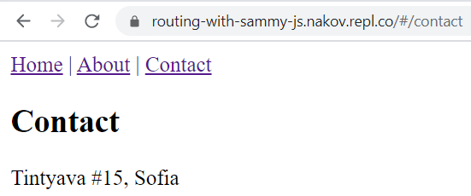
Routing with Sammy.js – Example (2)
<script>
$.sammy(function() {
this.get('/', function() { showView('home') });
this.get('/#/about', function() { showView('about') });
this.get('/#/contact', function() { showView('contact') });
}).run();
function showView(viewId) {
$('section').hide();
$('#' + viewId).show();
}
</script>

Slide 25
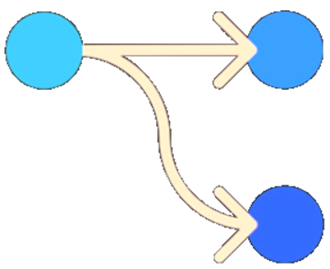
Navigation with Routing Library
Live Demo
https://repl.it/@nakov/routing-with-sammy-js
Notes:
Let’s demonstrate with live code example the idea of "routing" for changing the active view or page in Web apps.
As usually, we have a working code example at repl.it.
Let's look at it. It may take some time to load…
This is the code. We have several HTML sections (the views)
and some JavaScript code to switch between them based on the routes in the URL.
The code is based on a client-side front-end library called "Sammy.js",
but this a technical detail, which is not important now.
Let's run the code and see how it works.
We open it in a new tab.
We click on [Home], [About] and [Contact] and the view changes.
The URL in the browser's URL bar also changes.
This is how routing and navigation works.
This is a common concept in many Web technologies and frameworks,
as well as some desktop and mobile app frameworks.

Slide 26
User Interface and Front-End Frameworks
Graphical User Interface (GUI) systems provide forms, dialogs and UI controls for desktop and mobile apps
Examples: Windows Forms, XAML, WPF, Qt
Mobile UI toolkits / frameworks provide UI controls and structure for mobile apps
Examples: Apple UIKit, Android UI, Flutter
Web front-end frameworks and UI libraries provide user interface elements and structure for Web apps
Examples of UI frameworks: Angular, React, Vue.js, Meteor
Examples of UI libraries: Kendo UI, Sencha Ext JS, Onsen UI
Notes:
User interface (UI) technologies and front-end frameworks are powerful tools for building client-side apps for Web, desktop, mobile and others environments.
These technologies change fast over the time, but many concepts and patterns behind them remain similar.
Such concepts include a tree of components (like the DOM tree), "inversion of control" program flow, event-driven approach, message-driven communication between components, state management, data binding and many others.
Graphical User Interface (GUI) systems provide forms, dialogs and many UI controls for desktop and mobile app development.
Development environments often provide visual UI builders to speed-up UI development for certain UI toolkit or framework.
Unlike Web technologies, GUI programming is usually platform-specific, and the skills are not directly transferrable from one platform to another, for example from Microsoft Windows to Apple iOS.
Examples of GUI toolkits are:
Windows Forms, XAML and WPF, which are created by Microsoft for the MS Windows platform,
and Qt, which works in Linux and is also portable to other operating systems and graphical environments.
Mobile UI toolkits and frameworks provide structure, programming model and UI controls for building mobile apps.
Mobile UI toolkits are platform-specific and differ between iOS, Android and the other mobile platforms.
But many concepts from these technologies are similar and once a developer learn one mobile UI technology, it is easy to learn the others.
Examples of mobile UI toolkits are:
Apple UIKit, which comes from Apple and is used to build iPhone and iPad apps in the Swift language,
Android UI, which comes from Google and is used to build native mobile apps in the Java language,
and Flutter, which is UI toolkit also from Google, designed to be a multi-platform and it supports Android, iOS, Web and desktop appp development with a single codebase, written in the Dart language.
Web front-end frameworks and HTML5 UI libraries provide
structure, programming model and user interface elements for building Web apps.
These frameworks and libraries significantly speed-up the development, improve the maintenance and the quality of front-end apps.
Examples of Web front-end UI frameworks are:
Angular – a popular and very powerful end-to-end Web front-end framework, maintained by Google;
React – a popular library for building component-based Web front-end user interfaces, developed and maintained by Facebook,
Vue.js – a popular Web front-end framework for building single page apps,
and Meteor – a popular development platform and UI framework for Web front-end, mobile and Web apps.
Examples of Web front-end UI libraries are:
Kendo UI,
Sencha Ext JS,
and Onsen UI
All these are libraries, holding ready-to-use UI controls, that simplify and speed-up front end development.

Slide 27
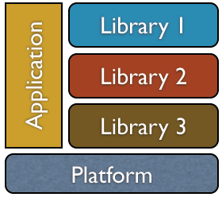
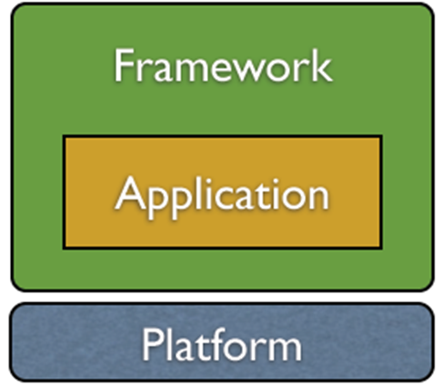
Libraries vs. Frameworks
Libraries provide components / functionality / UI controls for integration into existing apps
The app controls the library components
Examples: UI control library, Excel reader
Development frameworks are foundations, which developers extend to build an app
The framework controls the app lifecycle and your code plugs in it (inversion of control – IoC)
Examples: MVC framework, ORM framework
Notes:
We mentioned many times "libraries" and "frameworks".
Both are tools to simplify and speed up software development,
and both provide ready-to-use functionality and building blocks that developers use in their apps.
Libraries and frameworks are similar concepts, but there is a conceptual difference between them.
Let's now explain the difference.
Libraries provide components, functionality and UI controls for integration into existing apps.
Libraries use the "traditional program flow".
The app controls the library components and invokes their functionalities from time to time.
Library components act as extensions to the app.
This is illustrated at the diagram on the right.
Examples of libraries are:
A UI control library, which provides many UI controls, such as "calendar" or "image slider".
An "Excel reader" library, which can open and read Excel spreadsheets.
Development frameworks are foundations, which developers extend to build an app.
The framework controls the app lifecycle and your code plugs in it.
Frameworks use the "inversion of control" program flow.
The framework takes control and invokes your code from time to time.
Your code acts as an extension to the framework.
This is illustrated at the diagram on the right.
Examples of frameworks:
Web MVC frameworks like Spring MVC, Django and Laravel.
ORM frameworks like Doctrine, Entity Framework and SQLAlchemy.
In short:
Libraries provide components, and these components are plugged into your code to implement certain functionality.
Frameworks are "app foundations" and your code plugs into them to extend their basic functionality, following their programming model.

Slide 28
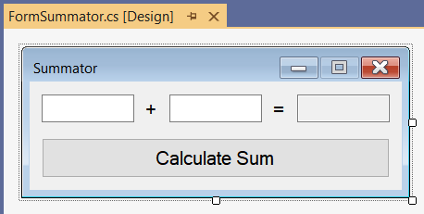
Windows Forms – Example
Windows Forms is GUI framework for .NET developers
Provides programming model and rich UI control library
public partial class FormSummator : Form
{
private TextBox textBox1;
private Label labelPlus;
private Label labelEqual;
private TextBox textBox2;
private TextBox textBoxSum;
private Button buttonCalc;
}
Notes:
This is a simple example how GUI frameworks work.
Windows Forms is a classical software framework for development of Desktop graphical user interface (GUI) apps for Microsoft Windows.
It is based on the .NET platform and the C# language.
Windows Forms provides programming model and rich UI control library for building GUI apps.
Additionally, the Visual Studio IDE provides a powerful visual UI builder for Windows Forms,
where developers design the user interface by dragging and dropping UI controls
and configuring their properties and events.
Windows Forms is an object-oriented framework.
Your app is a "form", which is an object-oriented class.
This class inherits its functionality and behavior from a base class from the framework.
Additional UI controls (such as labels, text boxes and buttons) are added as data fields in the app class.
The app UI controls are inserted into the tree of components, in the parent container.

Slide 29
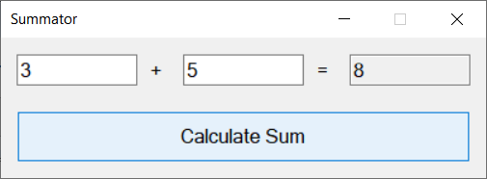
Windows Forms – Example (2)
public partial class FormSummator
{
private void buttonCalc_Click(object sender, EventArgs e)
{
decimal firstNum = decimal.Parse(this.textBox1.Text);
decimal secondNum = decimal.Parse(this.textBox2.Text);
decimal sum = firstNum + secondNum;
this.textBoxSum.Text = sum.ToString();
}
}
Notes:
This is the event handler for the "button click" event for the [Calculate Sum] button in the app.
This is a C# code, which follows the Windows Forms programming model.
The program logic here does the following:
takes the texts from the first two boxes,
converts it to numbers,
calculates their sum
and displays the sum in the third text box.
The technical implementation is not important here.
You can focus on the idea how GUI apps work, not on this particular example and its C# code.
The important concept here is how the app is built, by extending a class from the UI framework,
how the app is built from composition of components,
and how event handlers are called by the framework to add functionality to the components in the app.

Slide 30
Windows Forms
Live Demo
Notes:
Now let's see the previous example in action.
I have prepared a Visual Studio project, holding the Windows Forms app from the example.
This is the form designer in Visual Studio for Windows Forms GUI apps.
On the left we see the "Toolbox".
It holds a list of UI controls, available from the UI framework.
At the center we see the main app form with the UI controls, inserted in it.
We can see the C# code, generated by the UI designer tool, by clicking [F7].
We have 2 files behind the form: FormSummator.cs and FormSummator.Designer.cs.
On the right we see the app files (Solution Explorer) and the "Properties" editor.
When we select certain UI control in the form designer (like this textbox), we see on the right its properties:
name, location, size, font, text content and others.
When we double click on certain UI control, we can edit the C# code for its default event handler.
We double click the [Calculate Sum] button.
We see the C# code, which will be executed, when the button is clicked by the app user.
This is the code we already discussed: it takes the values from the first two text boxes,
calculates their sum and displays it in the third text box.
We run the app by clicking the [Start] button in Visual Studio.
It takes some time to compile and build the app.
And this is our app: live and running.
We enter "3" and "5" and we calculate their sum "8".
The code here is not important.
Don't try to understand it completely!
I just want to show you what a GUI framework is,
and how a UI designer tool can simplify GUI app development.
And all of this as a concept, not specifically the Windows Forms technology.

Slide 31
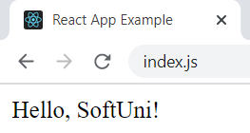
React
React is a powerful JavaScript library from Facebook for building Web UI using HTML, CSS and JS
The UI is built from JSX components, which combine HTML + JS
class HelloMessage extends React.Component {
render() {
return (<div>Hello, {this.props.name}!</div>);
}
}
ReactDOM.render(<HelloMessage name="SoftUni" />,
document.getElementById('root'));
Notes:
When we talk about user interface and front-end frameworks, it is worth mentioning React.
React is a powerful JavaScript library from Facebook for building Web user interfaces using HTML, CSS and JavaScript.
The UI is built from JSX components, which combine HTML + JavaScript using a built-in templating engine.
React is а component-based UI library.
With React, developers create reusable UI components,
which have own lifecycle, internal state and behavior.
It is discussable whether React is a library or a framework.
It is maybe somewhere between.
By adding some additional components like React Router, MobX, Redux, Flux, React Toolbox, and some others,
we can turn React into a fully-functional Web front-end framework.
Let's look at this simple example of React component (a JSX component):
It is a JavaScript class, which defines a UI component called "HelloMessage".
It takes a parameter called "name" and renders "Hello" + the name in a <div>.
After that, this new component <HelloMessage> with argument name="SoftUni" is rendered in the page.
The HTML result page is shown in the image on the right.
Pretty simple.
As usually, I don't want to put your focus on the code and the technology here.
It is more important to understand the concepts behind this approach to building user interfaces,
which is based on creating reusable self-contained UI components.

Slide 32
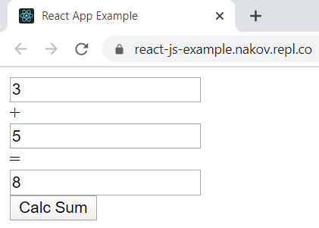
Simple React App – Example
import React, { useState } from 'react';
function Summator() {
const [num1, setNum1] = useState();
const [num2, setNum2] = useState();
const [sum, setSum] = useState();
return (
<div className="Summator">
<input type='text' value={num1} onChange={e => setNum1(e.target.value)} /> +
<input type='text' value={num2} onChange={e => setNum2(e.target.value)} /> =
<input type='text' value={sum} readOnly='true' />
<button onClick={() => setSum( Number(num1) + Number(num2))}>Calc Sum</button>
</div>
);
}

Slide 33
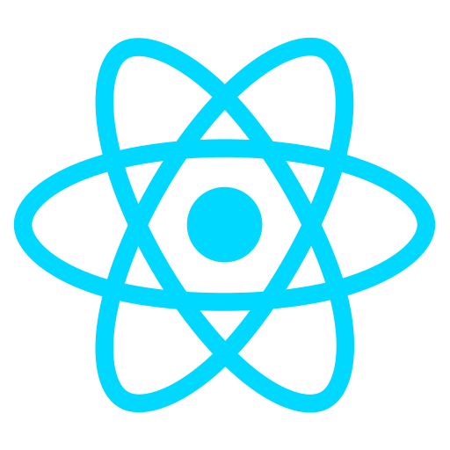
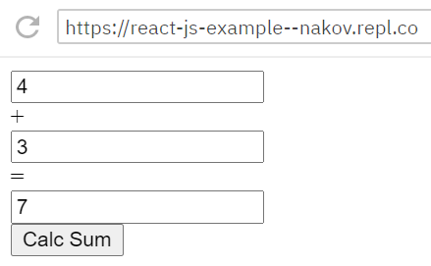
React
Live Demo
https://repl.it/@nakov/react-js-example
Notes:
Let's see another, more complex example of React project.
We have a live code example in repl.it, which implements a summator app.
The app takes two numbers and calculates their sum.
It takes some time to load, more than usually, because the React environment needs a lot of packages to be loaded and configured.
When the project loads, we can see its structure:
index.js – it holds the app entry point and renders the "Summator" component.
Summator.css – holds the CSS styles for the "Summator" component.
Summator.jsx – holds the main JSX component "Summator".
It defines 3 input fields and a button + an event handler for the button.
When the button is clicked, its event handler sums the first two fields
and saves the result into a state variable, which is bound to the last field.
Please don't try to understand all the technical details and how the code works.
This is just an example, which demonstrates certain UI technology.
The focus here is the concept of creating reusable UI components
and the concept of "data binding" between a state variable and a text field.
Now we can run the example.
We enter "4" and "3" and click [Calc Sum] and the calculated result is "7".
It works as expected.

Slide 34

Mobile Apps – Technologies
Two major mobile app platforms: Android and iOS
Mobile app development technologies
Android: Java / Kotlin + Android SDK + Android Studio
iOS: Swift (or Objective-C) + iOS SDK + Xcode + Mac
Hybrid mobile apps: JS + HTML5 + WebView (e.g. Cordova)
Native JS mobile apps: JavaScript + native UI
Examples: React Native, NativeScript
Others: Xamarin (C#), Flutter (Dart)
34
Notes:
Mobile apps are important branch of front-end and client-side app development.
Building mobile apps combines mobile development principles, concepts, platforms, technologies, frameworks, libraries and tools.
Two major mobile app platforms dominate the smartphone and mobile device markets: Android and iOS.
Android is more popular.
Devices are less expensive (compared to iOS devices).
Developers have more freedom and options.
Most apps are free or follow a freemium model.
iOS is slightly less popular, but still very big.
Devices are more expensive,
but the market is more profitable, because most apps follow a paid model.
Mobile app development technologies are divided into several categories:
Android native mobile apps.
Native Android apps are created specifically for the Android platform (which is maintained by Google).
They are based on Java or Kotlin (as programming languages) + Android SDK (as development toolset) + Android Studio (as development environment) + some specialized tools (like Android emulators, simulators, remote debugging tools and others).
Advantages of the native Android apps are that they are native and use directly the Android platform, its APIs, its programming model, its UI controls and the apps behave more natively and are fast.
Disadvantages are that you need to learn the Android platform and you cannot adapt the native Android app for iOS.
iOS native mobile apps:
Native iOS apps are created specifically for the Apple iOS platform.
They are based on Swift (or the older Objective-C) as programming languages + iOS SDK (as development toolset) + Xcode (as development environment) + some specialized tools (like device emulators, remote debugging tools and others).
As a rule, to develop iOS apps, you need a Mac machine.
You cannot develop iOS apps from Windows or Linux (at least officially).
Advantages of the native iOS apps are that they are native and use directly the iOS platform, its APIs, its programming model, its UI controls and the apps behave more natively and are fast.
Disadvantages are that you need to learn the iOS platform, you need to have a Mac computer and you cannot adapt the native iOS app for Android.
Hybrid mobile apps are based on the modern Web technologies, running in the mobile device's Web browser.
Hybrid mobile apps are based on JavaScript and the HTML5 platform.
They use а WebView container (which is an embedded Web browser) through the Apache Cordova or similar project.
The app codebase is written in JavaScript.
The UI is based on combination of HTML + CSS and some adaptations of the native Android and iOS UI controls.
Hybrid mobile apps can access the mobile device hardware through specific APIs.
Advantages of the hybrid mobile development approach are:
Shared codebase for all platforms. The same code runs (with small adaptations) on both iOS and Android.
Existing Web front-end development skills are reused.
Disadvantages are that hybrid apps behave less natively from the user experience perspective and are slower than native apps.
Native JS mobile apps use JavaScript as programming language (instead of Java or Swift),
but the user interface is bound to the native UI toolkit for the target mobile platform.
Examples of native JS mobile app platforms are: React Native and NativeScript.
Advantages of the native JS mobile platforms are:
Shared codebase: most of the code is shared between the iOS and Android app, except some specific UI-related code.
The apps behave natively, just as native Android or iOS app.
Disadvantages are that existing HTML5 and Web front-end development skills cannot be used directly.
Other platforms try to combine the best from the native and hybrid mobile apps:
Xamarin is a C#-based mobile development platform, which targets Android and iOS, but have similar disadvantages like hybrid mobile apps: bad performance and non-native user experience.
Flutter is trying to offer a universal development platform for iOS + Android + Web + Desktop, based on the Dart programming language, which is fast, natively compiled, and uses a shared codebase for all platforms.

Slide 35
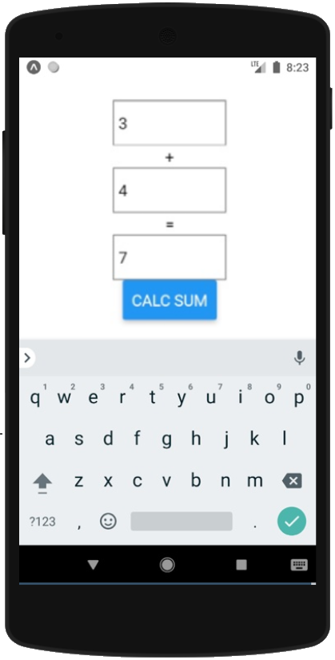
React Native Mobile App – Example
import React, { useState } from 'react';
import {View, TextInput, Text, Button } from 'react-native';
export default function Summator() {
const [num1, setNum1] = useState();
const [num2, setNum2] = useState();
const [sum, setSum] = useState();
return (<View style={{…}}>
<TextInput style={{…}} value={num1}
onChangeText={text => setNum1(text)} /><Text>+</Text>
<TextInput style={{…}} value={num2}
onChangeText={text => setNum2(text)} /><Text>=</Text>
<TextInput style={{…}} value={sum} editable={false} />
<Button title="Calc Sum" onPress={() => setSum("" + (Number(num1) + Number(num2)))} />
</View>);
}

Slide 36
React Native App
Live Demo
https://snack.expo.io/@nakov/summator-react-native
Notes:
As illustration of the mobile development platforms and concepts,
I have prepared a small live code example of React Native mobile app.
Let's look at the example from the link on the screen.
To save time, I have pre-loaded the sample project at the online development environment.
The app I have created, is a simple summator of numbers.
It sums the values from two text fields into a third field, when you click a button.
As you can see from the code at the screen, React Native apps are written in JavaScript, following the React programming model, with JSX components, but using universal cross-platform UI controls, which are bound to the native iOS and Android UI toolkits for better performance.
We can run the app in the iOS emulator at the right side of the development platform.
We enter "3" and "6" and the result is calculated as "9".
Works as expected.
I will skip explaining the code. It is not important now.
The important concept here is that developers can build mobile apps in JavaScript using their React skills with some adaptation for the mobile platforms.
Once they learn front-end development concepts and technologies like Angular and React, they can use these skills for different platforms: Web, desktop and mobile.

Slide 37
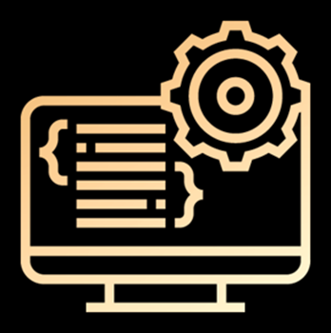
Back-End
Notes:
Back-end is the part of the software systems, which users don't see on their screens.
The back-end provide concepts, frameworks, libraries and tools to build business logic, implement data processing and data storage and exposе programming interfaces (APIs) for the front-end.
The back-end is the server-side part of the applications, where users and their data are stored and processed.
Let's review the most important principles and concepts from back-end devlopment.

Slide 38

Back-End Technologies
Back-end technologies are about server-side programming
Data management technologies and ORM frameworks
Backend Web frameworks and MVC frameworks
REST API frameworks, reactive APIs, other services and APIs
Microservices, containers and cloud
Back-end developers work on the server-side
They deal with the business logic, data processing, data storage, APIs
Notes:
Back-end technologies are the technologies, platforms and frameworks, which run at server-side part of software systems.
The server-side software components implement logic and processing, which are not related to the user interface.
Back-end technologies provide concepts, frameworks, libraries and tools to build business logic, implement data processing and data storage and exposе programming interfaces (APIs) for the front-end.
Let's look at some of these back-end technologies:
Data management technologies, databases and ORM frameworks,
such as MySQL, PostgreSQL, Entity Framework and Hibernate.
Backend Web frameworks and MVC frameworks,
such as Spring MVC, Django and ASP.NET MVC.
REST API frameworks, reactive APIs, and other services and APIs,
such as ASP.NET Web API, Flask-RESTful and RxJava.
Microservices, containers and cloud,
such as Docker images in Azure and Amazon AWS.
All these back-end technologies are available with:
different programming languages (such as C#, Java, JavaScript, Python, PHP, C++, Go, Swift and others)
and development platforms (such as .NET Core, Java EE, Node.js and others).
Back-end developers play an important role in software development.
They work on the server-side of software systems.
This is a popular profession in the software industry.
Back-end developers deal with the business logic, data processing, data storage and service APIs.
They use database servers, backend platforms, application servers, containers, cloud environments and many other back-end technologies and tools.
The back-end components are often deployed as containers in a cloud environment
or are built specifically for certain cloud platform,
so back-end developers often deal with cloud and DevOps.
Now, let's look at details about databases, ORM systems, MVC frameworks, containers, and operating systems.

Slide 39
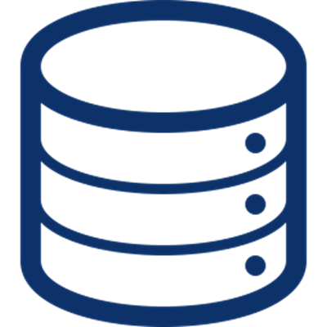
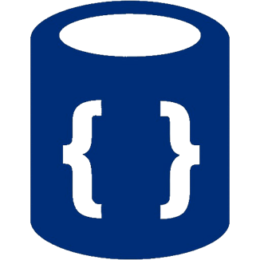
Databases
Databases hold and manage data in the back-end systems
Relational databases (RDBMS)
Hold data in tables + relationships
Use the SQL language to query / modify data
Examples: MySQL, PostgreSQL, Web SQL in HTML5
NoSQL databases
Hold collections of documents or key-value pairs
Examples: MongoDB, IndexedDB in HTML5
Notes:
Databases hold and manage data in the back-end systems.
Almost all software systems use a database in some form.
The data in database systems is organized in tables (holding rows), collections (holding objects), key-value pairs or other structures.
The software, which manages, retrieves and manipulates data in a database, is called DBMS (database management system).
Examples of DBMS systems are MySQL, MongoDB, Redis, Azure Cosmos DB, PostgreSQL, MS SQL Server, SQLite, Elasticsearch and thousands more.
DBMS systems are responsible for:
Data definition: creating and deleting databases, creating and modifying collections, tables or other sets of data records or documents and defining their structure, fields and data format;
Data retrieval: retrieving data, querying data, searching data, filtering data, extracting data, combining data, aggregating data;
Data manipulation: inserting new data, modifying existing data, deleting existing data;
Data administration: users, roles and access control, concurrency control, monitoring, replication, backup and recovery and others
Modern software systems use a DBMS system to manage data, instead of implementing the data management internally.
Relational databases organize data in tables and data rows.
For example, an e-commerce software could have a table holding the products:
Each table row could hold product id, product name, description, vendor, and price.
Some tables in the RDBMS system maintain relationships between them.
For example, one vendor has many related products and each product has a vendor.
This is called "one-to-many relationship".
In relational database the SQL language is used to query and modify data.
SQL (structured query language) is standard database query and manipulation language.
It support simple and more complex commands, such as "SELECT name, price FROM products".
The software packages, which manage relational databases, are called "RDBMS – relational database management systems".
Examples of RDBMS system are MySQL, PostgreSQL, MS SQL Server, Oracle Database and Web SQL (in the HTML5 platform).
We shall learn more about databases and SQL in the database modules and courses in the end-to-end software engineering training program at SoftUni.
NoSQL databases hold collections of documents or key-value pairs.
Document databases (like MongoDB) manage collections of documents (such as products or vendors),
where each document has a set of properties (like name, price and description).
Document databases support
retrieving and querying document collections,
and creating, modifying and deleting documents.
Examples of document-based NoSQL databases are MongoDB and IndexedDB in the HTML5 platform.
Key-value pair databases, such as Redis and Amazon DynamoDB, store keys mapped to values.
These key-value pair structures are also known as "dictionaries".
They support fast "search by key" operation,
but storing collections of data is less flexible.
Key-value data storage systems are good for organizing simple data.
For example, a phonebook can be stored in a key-value store.
Database systems are an important component of most modern software systems,
and therefore software engineers must have at least basic database skills.

Slide 40
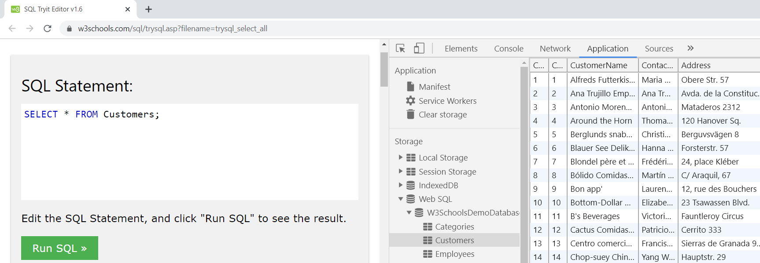
Web SQL – Example
Web SQL is a relational database, embedded the Web browsers
It is fully functional RDBMS system, runs at the client-side
Notes:
To illustrate the concept of database systems, we shall take an example.
Web SQL is a relational database system (RDBMS), embedded in the modern Web browsers.
Web SQL is part of the HTML5 platform, which is used to build front-end apps using HTML + CSS + JavaScript.
It is fully functional RDBMS system, which runs at the client-side (in the Web browsers of Internet users).
Web front-end developers can use Web SQL to store local data in a structured format (as database tables with relationships).
The database is stored in the Web browser, just like cookies and cached images are stored in the laptops and smartphones of Internet users.
Each Web app could create and manipulate a local Web SQL database.

Slide 41
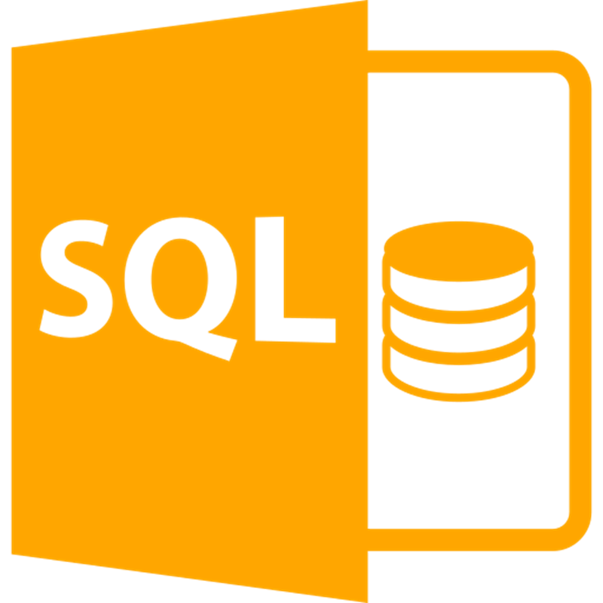
Web SQL
Live Demo
https://w3schools.com/sql/
Notes:
Let's see this live example of Web SQL.
We open the live demo link: https://w3schools.com/sql.
This is a free tutorial for SQL and databases, available in Internet.
We click on the [Try it Yourself] button.
It opens a command window, where we can type SQL commands and execute them.
The default SQL command is "SELECT * FROM Customers".
Let's execute is. We press the [Run SQL] button.
The result is a table, holding records.
We can modify the SQL query like this:
"SELECT Country, City FROM Customers"
and we run it.
The result consists of the columns "Country" and "City" from the table "Customers".
We can also display the Products table by a similar SQL query:
"SELECT * FROM Products"
Recall that in relational databases, data is structured as tables.
Let's see the tables in our local Web SQL database.
We press [F12] to open the Chrome DevTools.
We go to the [Application] tab and choose [Web SQL] and open it.
We can browse the tables and their data rows.
This is an example of relational database: tables and relationships between the tables.
Click on the [Products] tables. It holds product names, prices and other data about the products.
The interesting point here is the SupplierID column. It holds a relationship to the [Supplier] table.
Let's take the product "Tofu" (line 14).
It has SupplierID = 6.
Which is this supplier?
We can check in the table [Suppliers].
It is "Mayumi's" from Osaka, Japan.
I hope you now have an idea what is a database, what is a table and relationship with another table and how data is organized in databases.
We shall learn more about databases in the database modules and training courses at SoftUni.

Slide 42
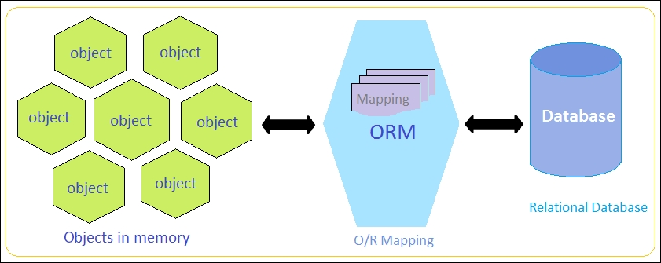
ORM Frameworks
ORM frameworks (object-relational mapping) allow persisting objects in relational database (by mapping classes to tables)
E.g. store JS objects in MySQL database
Popular ORM frameworks:
Entity Framework (C#)
Hibernate (Java)
Sequelize (JavaScript)
SQLAlchemy (Python)
Notes:
When we talk about databases, it is important to mention some data access technologies.
Data access technologies connect programming languages with database systems.
These technologies allow creating databases, defining the data format, storing and manipulating data and retrieving data, using simple or more complex data queries or by executing SQL commands.
For example, the JDBC technology connects Java programs to relational databases, such as MySQL and PostgreSQL.
ORM frameworks (object-relational mapping) allow persisting objects in relational database.
ORM frameworks work by mapping classes to database tables.
Instead of executing SQL commands, when developers use ORM, they work with simple data classes and APIs from the ORM framework to handle the CRUD operations (create, read, update and delete), query the database and execute database-related operations.
This dramatically simplifies the implementation of data access logic in software development.
Examples of using ORM systems are when we need to:
persist JavaScript objects in MySQL database,
or persist Java objects in PostgreSQL database,
or persist C# objects in MS SQL Server database.
These are a few examples of popular ORM frameworks:
Entity Framework, which is the most popular ORM for the C# language and the .NET platform.
Hibernate and Java Persistance API (JPA), which are used as ORM frameworks in Java projects.
Sequelize, which is a popular server-side JavaScript ORM framework for persisting JavaScript objects in relational databases.
SQLAlchemy, which is a popular ORM framework for Python.

Slide 43
ORM Example – JayData ORM for Web SQL
<script src="https://unpkg.com/jaydata@1.5.10/public/jaydata.js"></script>
<script>
let Task = $data.Entity.extend("Task", {
Id: { type: "int", key: true, computed: true },
Task: { type: String, required: true, maxLength: 200 },
DueDate: { type: Date },
Completed: { type: Boolean }
});
let TodoDatabase = $data.EntityContext.extend("TodoDatabase", {
Tasks: { type: $data.EntitySet, elementType: "Task" }
});
let todoDB = new TodoDatabase({
provider: 'webSql', databaseName: 'TodoDB'
});

Slide 44
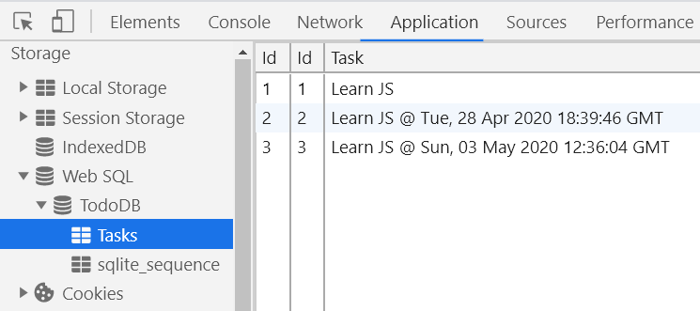
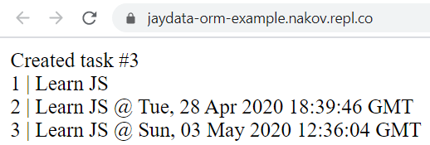
ORM Example – JayData ORM for Web SQL (2)
todoDB.onReady(async function() {
// Create a new task in the table 'Tasks'
let newTask = todoDB.Tasks.add(
{ Task: 'Learn JS @ ' + new Date().toUTCString() });
await todoDB.saveChanges();
document.write("Created task #" + newTask.Id);
// List all tasks
let tasks = await todoDB.Tasks.toArray();
tasks.forEach(task => document.write( `<div>${task.Id} | ${task.Task}</div>`)
);
});
</script>

Slide 45
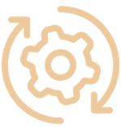
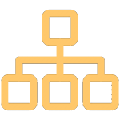
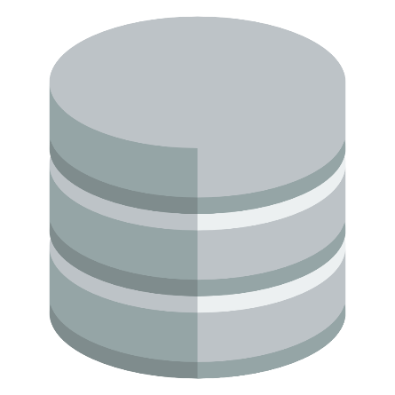
JayData ORM for Web SQL
Live Demo
https://repl.it/@nakov/jaydata-orm-example
Notes:
The get a better idea of how ORM frameworks work, I have prepared for you a live code example.
In this example we use a local Web SQL database to hold tasks for a TODO list app.
We use a simple ORM framework for JavaScript, called "JayData ORM", and we map the database to JS objects.
Let's see the demo code:
We open the link to repl.it.
We wait for the example to load. It takes some time.
We run the code and we see a list of data rows (tasks from our TODO list).
Then, we can look at the database in the Web browser.
We open the result in a new window.
We click [F12] to show the Chrome DevTools.
Then we open [Application], then [Web SQL], then the [TodoDB] database and the table [Tasks].
We see the content of the table "Tasks", its columns and data rows.
Let's look at the source code.
It defines an entity class "Task", which describes a task and its fields.
This entity corresponds to the rows from the table "Tasks" in the database.
The next declaration defines the database with the "Tasks" entity set (the "Tasks" table in the database).
Then the database is connected to the local Web SQL data provider in the Web browser.
Then, after connecting to the database, a new data row is created and saved to the database.
Finally, all tasks are retrieved from the database and are printed in the Web page.
Please don't try to understand all the technical details in the code.
Instead, try to understand the main concept of ORM.
It maps database rows to objects from an entity class
and provides and API for the CRUD operations (create, read, update, delete).

Slide 46
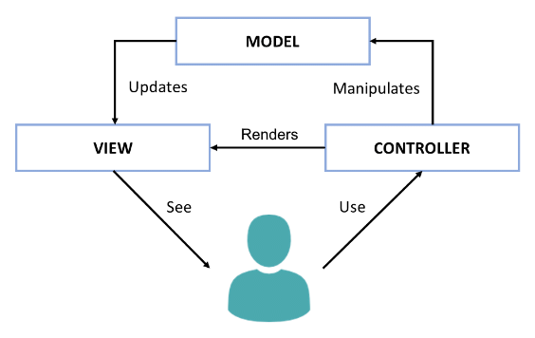
The Model-View-Controller (MVC) Pattern
The Model-View-Controller (MVC) pattern
Controller
Handles user actions
Updates the model
Renders the view (UI)
Model
Holds app data
View
Displays the UI, based on the model data
Notes:
Another important concept from software development is the Model-View-Controller (MVC) pattern.
MVC is an architectural pattern for structuring Web back-end apps,
by dividing their logic into 3 separate components: models, views and controllers.
The MVC pattern is illustrated at the diagram, which shows the interactions between the MVC components.
MVC is complex and some developers need time to understand it.
We shall spend significant time, effort and practical work to learn it, later at SoftUni.
But now, let's briefly explain the MVC pattern.
MVC splits the app into controllers, views and models.
Users interact with the controllers, which modify the data in the models and visualize the data using the views.
For example, let's take a phonebook app.
Users see the phonebook entries on the screen. They are rendered by a view component.
The app model holds the phonebook entries. This is the data model behind the views.
Controllers are responsible for handling the user actions, such as "view the phonebook", "search", and "add new entry".
The controllers, models and views are strongly interconnected, but each of them has well defined responsibility.
The idea of MVC is to build a better app structure, which simplifies development and improves maintenance.
The presentation logic, which displays elements on the screen is always located in the views.
The logic for user interaction, which handles the user input, is always located in the controllers.
The data models and data related logic are in the models.
The MVC app structure is very popular in Web back-end frameworks (such as ASP.NET MVC, Django and Spring MVC).
Variants of MVC sometimes are used in some Web front-end frameworks and mobile app frameworks.
In the MVC model, controllers handle user actions, such as clicking a button or choosing an item from a list.
Depending on the user action, controllers may update the app data model.
Then, controllers render a view (the user interface), which visualizes the data model.
For example, in our phonebook app, the phonebook controller handles the action "click on a phonebook entry".
The action handler loads the data about the selected phonebook entry into a data model object.
Then it shows a view, which displays this data object.
Models holds app data.
Typically models are data classes, which hold the data, that should be displayed at the screen.
For example, in our phonebook app, the data model, used to visualize a phonebook entry, is a data object, holding the phonebook entry details.
Views displays the UI for certain screen from the app, based on the data from the model.
For example, in our phonebook app, the view, which displays the phonebook entries,
takes as an input a data model, holding a list of phonebook entries.
The view iterates over the entries one by one and displays them in a table or list.
MVC is an important paradigm for structuring Web apps back-end developers should learn it.
At SoftUni, we teach MVC as part of the server-side Web development courses and modules.

Slide 47
Web MVC Frameworks
Web MVC frameworks are used build Web applications
Controllers handle HTTP GET / POST and render a view
Views display HTML + CSS, based on the models
Models hold app data for views, prepared by controllers
Examples of Web MVC frameworks:
ASP.NET MVC (C#), Spring MVC (Java), Express (JS), Django (Python), Laravel (PHP), Ruby on Rails (Ruby), Revel (Go), …
Notes:
Web MVC Frameworks are software development frameworks, which implement the Model-View-Controller pattern as foundation to build Web apps.
Web MVC frameworks (such as Spring MVC, Django and ASP.NET MVC) are used build server-side Web applications.
Under the MVC framework Web apps define controllers (holding actions), views and model components.
Actions in the controllers handle the HTTP GET and POST requests from the client Web browser.
They perform the requested operation (such as retrieving data or adding new data)
and render a view to display the result in the client Web browser.
Controllers implement the operations, used to interact with the users.
These operations are invoked as HTTP requests by the client Web browser.
For example, clicking a button, or submitting a Web form, executes an HTTP request,
which is handled by a controller action at the back-end.
Views render data as HTML + CSS for displaying in the client Web browser.
Views are called by the controller actions to render the UI.
They take as input a data model and visualize the data from the model as HTML.
The rendered HTML is returned as an HTTP response.
For example, a view can render a list of items as HTML.
Models hold the app data, which is prepared by controllers to be rendered in the views.
In most cases models are simple data objects or collections of objects.
When a controller wants to return data for displaying in the client Web browser,
it loads the data from the database, puts it in a data model object,
and sends it to the view, which renders it for as HTML.
Examples of popular back-end Web MVC frameworks are the following:
ASP.NET MVC (for C# developers),
Spring MVC (for Java developers),
Express.js (for server-side JavaScript developers),
Django (for Python Web developers),
Laravel (for PHP Web developers),
Ruby on Rails (for Ruby developers),
Revel (for Go Web developers),
and many others …
Almost all the server-side Web development is driven by Web MVC frameworks,
so you need to learn at least one of them if you want to be a back-end developer.
We shall learn MVC frameworks at SoftUni, at the end of our end-to-end training program for software engineers.

Slide 48
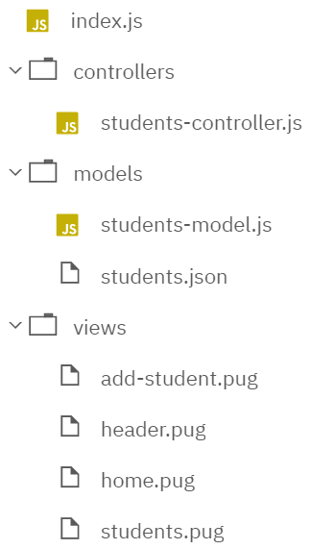
MVC Web App – Example
const express = require('express');
const app = express();
app.set('view engine', 'pug');
app.use(require('body-parser')
.urlencoded({extended:true}));
const studentsController =
require("./controllers/students");
studentsController.setup(app);
app.listen(8080);
index.js

Slide 49
MVC Web App – Example: Controllers
let studentsModel =
require("../models/students");
function setup(app) {
app.get('/', function(req, res) {
let model = {
title: "MVC Example",
msg: "Students Registry",
students: studentsModel
};
res.render('home', model);
});
students-controller.js
app.get("/students",
function(req, res) {
let model = {
title: "Students",
students: studentsModel
};
res.render(
'students', model);
}
);
…
Render the UI template views/students.pug
Render the UI template views/home.pug

Slide 50
MVC Web App – Example: Models
const fs = require('fs');
module.exports = JSON.parse(
fs.readFileSync('./models/students.json'));
students-model.js
[
{"name": "Marry", "email": "marry@gmail.com"},
{"name": "Steve" , "email": "steve@yahoo.com"},
{"name": "Teddy" , "email": "teddy@mail.ru"}
]
students.json

Slide 51
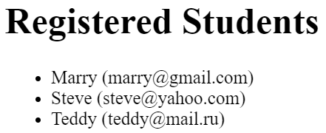

MVC Web App – Example: Views
include header.pug
h1 Registered Students
ul
each s in students
li #{s.name} (#{s.email})
students.pug
html
head
title=title
body
a(href='/') Home
span |
a(href='/students') View Students
header.pug

Slide 52
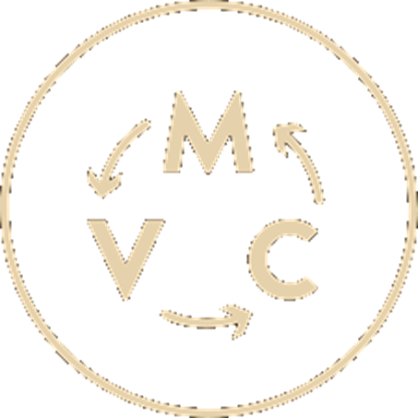
MVC Frameworks
Live Demo
https://repl.it/@nakov/MVC-express-pug-example
Notes:
To illustrate how MVC frameworks work in action, I have prepared a live code example project.
This is a simple Web app, which holds a registry of students.
The app is written in JavaScript, using Node.js.
It uses Express.js as a server-side MVC framework
and Pug as a templating engine to implement the views.
The app is structured as classical Web MVC application, consisting of controllers, views and models.
Let's first see it in action.
We open the link to repl.it and wait for the code to load.
We run the app and we see the home page.
We open the app in a new browser window.
This is because we want to see the URLs of the pages better.
The app has 3 tabs: [Home], [View Students] and [Add Students].
At the home page we see the number of students.
The URL of the home page is the URL of the app.
At the "view students" page we see a list of registered users.
The URL of this page is "/students".
At the "add students" page we see Web form for registering a new student.
The URL of this page is "/add-student".
Let's add a student, for example "Peter" with email "peter@gmail.com".
After clicking the [Add] button, the new student is added to the registry and the browser is redirected to the "view students" page.
This is all the functionality we have in this app.
Now, let's look at the code.
Is it complex. Don't try to understand it! Just get and idea of controllers, models and views.
We open the "controllers" folder and the "students-controller.js".
This controller defines 4 actions, bound to the following HTTP endpoints:
GET /: this action retrieves the home page.
It creates a data model (simple JavaScript object) and puts some data in it for visualization.
Then it renders the view with the name "home", which should visualize the data from the model.
GET /students: this action loads the student data and renders it through the view "students".
GET /add-student: renders the "add student" HTML form.
POST /add-student: adds the received from the HTTP request new student data to the students collection and redirects to the "students" page.
Let's see how the models look like:
The "students" model is loaded from a JSON file.
The JSON file holds 3 students with their name and email.
Let's look at the views:
home.pug: it's very simple. It just prints the count of students.
header.pug: it holds the top navigation. It is included at the start of all other views.
students.pug: it iterates over the students and prints their name and email in a list.
add-student.pug: it displays a form to enter student's name and email with a submit button.
Don't try to understand the code with all its technical details.
Try to understand the MVC pattern: the concept of structuring Web apps as controllers + views + models.
MVC is an important development concepts and Web developers should understand it.
We shall learn MVC with a lot of practical examples and projects in the Web development module at SoftUni.

Slide 53
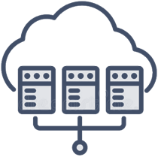
Virtualization and Cloud
Virtualization == running a virtual machine (VM) / virtual environment inside a physical hardware system
E.g. run Android VM or Linux inside a Windows host
Storage, memory, networking, desktops can also be virtual
Cloud == computing resources, virtual machines, storage, platforms and software instances, available on demand
IaaS (infrastructure as a service) – virtual machines on demand
PaaS (platform as a service) – app deployment environments
SaaS (software as a service) – software instances, e.g. Office 365
Notes:
Virtualization, cloud environments and containers are important infrastructural components in modern software development.
Virtualization in the concept and technology of running a virtual machine (VM) or virtual environment inside a physical hardware system.
Simply said, this is a virtual computer, running inside a physical computer.
In a single physical machine (called "host"), several virtual machines can run simultaneously.
For example, in a Windows desktop host, we can run simultaneously an Android virtual machine + two Ubuntu Linux virtual machines + a FreeBSD virtual machine.
Storage, memory, networking and desktops can also be virtual.
Virtual storage means that you can use remote or virtual storage infrastructure, to appear and function exactly like a local hard drive.
Example of virtual storage is the desktop Google Drive client, which displays your files from the drive, as local files on your computer.
Virtual memory is a technology, where external or remote memory resources could be used as local memory.
For example, a USB flash memory can be used as a disk cache in Microsoft Windows, in an effort to increase computing performance.
Virtual networking virtual network infrastructure to be distributed over Internet, without using a physical network equipment.
Virtual desktops are virtual desktop environments, running in a virtual machines, available remotely.
For example, developers may use a virtual Safari Web browser on macOS, for testing a Web front-end app.
Virtualization is a powerful concept and technology in software development and developers should be familiar with it.
The concept of "cloud environment", "cloud infrastructure" or just "cloud" plays an important role in modern computing.
The "cloud" consists of remote computing resources, virtual machines, storage, platforms and software instances available on demand.
The cloud infrastructure, platforms, services and cloud-based software is typically available for rent for a fee.
Some vendors provide free of charge limited versions of their cloud environments.
The cloud environments are offered in several service models:
Infrastructure as a service, platform as a service and software as a service.
IaaS (infrastructure as a service) provides virtual machines and other computing resources on demand, for a fee.
Examples of the IaaS model is when a company hires virtual servers to host their Web sites, or virtual machines do deploy their apps.
Under the IaaS model, developers and system administrators install, manage and maintain their virtual machines, the operating systems, configuration settings, backups, security and everything else.
IaaS services are offered by the major cloud infrastructure providers, such as Amazon AWS, Google Cloud, Azure, DigitalOcean and Rackspace.
The IaaS model is mostly for system administrators and developers who want to completely control their production environments.
PaaS (platform as a service) provides managed environments for app deployments.
"Managed" means that someone else cares about the hardware, software and its maintenance,
and guarantees that the requested environment and services are constantly up and running.
Developers don't care about the execution environment, only for their apps.
For example, you have a Python app and you want to host it in the cloud.
Instead of renting a cloud server, you could deploy and run the app in the Heroku PaaS cloud or in Azure PaaS.
The PaaS model provides cloud environment for deploying and running apps,
where developers do not care about the operating system, software platforms, application servers, database servers and other details.
Developers just send their source code or compiled app to the cloud, configure some settings and the app is live and running.
PaaS platforms typically provide a lot of managed platform services, such as:
databases (relational and document-based),
storage services (files, video, content-delivery networks and others),
message queue services,
logging services,
caching services,
machine learning and artificial intelligent services.
Developers use PaaS to simplify the development, deployment and maintenance of their apps and software systems.
The PaaS model is mostly for developers who want to focus on the software, rather than on the environment that hosts it.
SaaS (software as a service) provides managed software instances in the cloud.
Users pay for hosted software in the cloud (or get a limited version for free) and use it over Internet.
Examples of SaaS service are the Office 365 application suite, Google Docs and WordPress.com website hosting cloud.
The SaaS model is mostly for end users, not for developers.

Slide 54
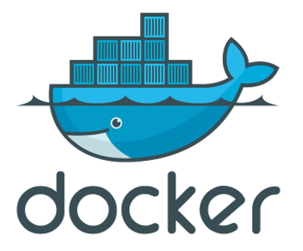
Containers and Docker
Container image == software, packaged with its dependencies, designed to run in a virtual environment (like Docker)
E.g. WordPress instance (Linux + PHP + Apache + WordPress)
Simplified installation, configuration and deployment
Docker is the most popular containerization platform
Runs containers from local image or downloaded from the Docker Hub online repository
Open-source, runs on Linux, Windows, Mac
Notes:
Containers, Docker and other containerization platforms (like "Linux Containers")
provide popular infrastructural concept and technology
to deploy, run and manage software installations and software environments,
packaged as "containers images".
A container image is a standalone executable software package,
bundled together with its dependencies (operating system, code, runtime and others),
and designed to run in a virtual execution environment (like Docker).
Container images are a set of files and folders, packaged as ZIP, TAR or other archive format.
When you run a container image, it creates and runs a virtual app, called "container".
Thus, a container is, ultimately, just a running container image in the host environment.
Containers bundle their own software, code, libraries and configuration files.
Containers are isolated from one another,
but can communicate with each other through well-defined channels.
The container host could start, stop, pause and resume the containers.
A container typically holds an app, together with its runtime environment:
the operating system (such as Ubuntu Linux) +
the app runtime (such as Node.js or Apache + PHP) +
the app code, or its compiled binaries (such as the WordPress source code in PHP) +
the app dependencies (such as libraries, frameworks and configuration settings, like curl, openssl and zlib).
For example, a WordPress instance can run in a container,
which runs Linux + Apache web server + PHP + some libraries,
and holds the WordPress code + some configuration files.
All these components are bundled together and run as a single application in an isolated environment.
The benefits of the containerization technology are:
simplified installation, configuration and deployment.
Containers allow automated configuration and management of virtual software environments,
using tools like Kubernetes.
Containerization is often associated with DevOps.
DevOps combines agile principles and technologies to implement continuous delivery, build automation, continuous integration, automated deployment, automated testing, automated releasing and automated monitoring of the software systems in the software development process.
DevOps engineers often use containers to implement automated provisioning of development, testing and production environments.
Docker is the most popular containerization platform.
It runs as a service on Linux, Windows, and many could environments.
Once you run Docker, you can create container images, using "Dockerfile" scripts.
Docker runs containers from local images
or from images, downloaded from the Docker Hub online repository,
or from images, created by "Dockerfile" scripts.
Docker containers are virtual app instances, which can be started, stopped or put at pause.
Developers can connect to existing Docker containers and manage them from the console.
Docker containers can expose network ports (like the HTTP port 80) to the host environment.
Thus, containers can serve Internet traffic from their host machine.
Docker is open-source software.
It runs on Linux, Windows and Mac.
Docker images can run in many cloud environments, such as "Amazon Elastic Container Service" and Docker for Azure.
Docker Compose is another container-based technology for defining and running multi-container Docker applications.
For example, using Docker Compose developers can run WordPress + MySQL,
in two separate containers, with an integration between them,
so that the WordPress instance store its data in the MySQL database.

Slide 55
Docker – Example
Install Docker on your local computer
Or use the Docker online playground: https://labs.play-with-docker.com (with a free Docker Hub registration)
Download and run a Docker image in a new container:
Open the exposed URL: http://localhost:8080
View currently running Docker containers
docker run -d -p:8080:80 dockersamples/static-site
docker ps
Notes:
Let's play a bit with Docker, to demonstrate its power.
You can install Docker on your local computer and run some Docker image.
Alternatively, you can use the Docker online playground from https://labs.play-with-docker.com.
It requires a free Docker Hub registration.
Let's open the Docker playground from the above link.
Now create a new Docker instance.
We shall see the Docker console.
We can type commands here.
For example, we can type "docker -v". It shows the Docker version.
Now, let's run a container.
The following command downloads a Docker image and runs it in a new container:
docker run -d -p:8080:80 dockersamples/static-site
We run the above command and we wait for its execution.
It takes some time to download the image and their dependencies.
The image name is "dockersamples/static-site".
This image will be downloaded from Internet, from the Docker Hub image repository.
The above command also maps the port 80 from the container to port 8080 at the host.
This way the Web server, running in the container, will be visible from the host machine and from Internet.
The "hypen d" option runs the container in background, instead of launching its console.
Now the container is up and running.
On the local machine we can open the exposed URL: http://localhost:8080.
In the Docker Playground the port 8080 from the Docker host is mapped to an automatically created URL.
We can open the [8080] link and we shall access the app from our container.
This Web page is served by the Web server, running inside the Docker container.
We can view the currently running Docker containers by the following command:
docker ps
It lists all containers, along with some details about them.
Now let's run a second container in parallel. We shall use a similar command:
docker run -d -p:8081:80 dockersamples/static-site
We run the same container, but we expose its port 80 to different port on the host machine.
We now have two containers running simultaneously on the host machine.
Now we can open the apps from these two contaners from their exposed ports.
Let's now login into the first container:
docker exec -it {process id or name} bash
This command executes in the specified container the "bash" shell in interactive (command line) mode.
The login is successful, and we can type commands inside the container:
Let's list the local files in the container: ls -al
View the content of the main Web page, served by the nginx Web server: cat index.html
Exit from the container's interactive shell: exit
We can stop certain container by the command:
docker kill + the process id or name
We can use the [Tab] key to autocomplete the container name.
Now the container is terminated, and the exposed Web sites are no longer available.
Note that it is normal if you don't understand everything about containers and Docker.
The idea of this demonstration is to understand the concept of "containers" as a tool to run pre-packaged apps and software environments.
Containerization is an important concept in software infrastructure and developers should be familiar with it.

Slide 56
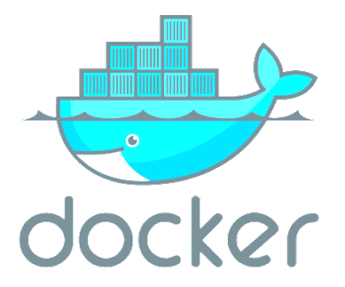
Play with Docker
Live Demo
https://labs.play-with-docker.com
Notes:
I already made a live coding demonstration about containers and Docker.
You can also experiment with Docker at the Docker Playground from the above link.
Try yourself and have fun.

Slide 57


Operating Systems
Working with operating systems (Linux, Windows, others) is an important skill for software engineers
Installation, configuration and basic system administration
Process management, file system, users and permissions
Sample Linux shell commands:
Create a file:
Rename a file:
View file contents:
cat > hello.txt
mv hello.txt welcome.txt
cat welcome.txt
Notes:
Working with operating systems (Linux, Windows, MacOS or others) is an important skill for software engineers.
Developers should understand the basic concepts of operating systems
and how processes, users, file system, the input and output and the console work.
Linux is the most important operating system for software developers.
Every developer should be familiar with the basic Linux console commands.
Other important Linux skills are:
Installation, configuration and basic system administration of Linux environments.
Installing and configuring software from the Linux shell.
Process management, working with the file system, configuring users and permissions, managing services.
Developers need all these skills, when they install, manage and troubleshoot production software,
hosted in Linux environment or in Linux-based containers.
Soon or later you will need to configure and manage the execution environment,
so find a way to learn the Linux basics.
These are sample Linux shell commands,
just to illustrate what a Linux console is
and what a Linux command is.
I will first start the Linux shell.
I have an Ubuntu Linux on my laptop.
This is the Linux shell.
I can write commands here.
Like "pwd". It shows the current directory.
Or the "whoami" command. It shows the current user.
Or the "echo" command, which prints a message. For example:
echo "Hello Linux shell"
Now let's create a file. The command is:
cat > hello.txt
This command creates a file named "hello.txt" in the current directory.
Then you can type some text and press [Enter]
Some text…
And more text…
Finally, press [Ctrl+D] to save the file and stop the "cat" command.
Now we have the file "hello.txt".
We can list the files in the current directory by the command:
ls -al
This is the file we created a moment ago.
Now we want to rename the file. We shall use the following command:
mv hello.txt welcome.txt
This command moves the file "hello.txt" into a new location, into a file named "welcome.txt".
The result is that the file changes its name.
We can list again the files in the current directory:
ls -al
Now we see the new file named "welcome.txt".
Let's view what's inside this file. We use the command:
cat welcome.txt
I can use the [Tab] key to auto-complete the current shell command.
This command will display the content of the file "welcome.txt" from the current directory.
Please do not try to learn all the commands mentioned.
Instead, try to understand the concept of Linux console as a command-based tool
for managing the operating system, the file system, processes and other objects in the OS.

Slide 58
Linux Shell Commands
Live Demo
https://repl.it/@nakov/bash-shell-example
Notes:
If you want to play with Linux commands yourself, you can follow the above link.
As usually, it takes some time to load.
This is a shell script, stored in a file "main.sh".
The script holds a sequence of Linux shell commands.
We can run the script and see its output.
It prints some text, then writes some text in a file, then displays the content of the file, then displays some information about:
the current machine using the "uname -a" command,
the current user using "whoami",
the active processes in the OS using "ps".
Please don't try to understand everything.
Instead focus on the concept of Linux shell and shell scripts.
They are important in software development.
The Linux shell allows to control the operating system through commands, executed in interactive mode.
Shell scripts consists of sequences of shell commands (like programs in programming) and are used to automate some task.

Slide 59
Internet of Things (IoT)
Notes:
Internet of Things (IoT) is the concept of using
connected devices, such as microcontrollers and mini-computers,
together with back-end infrastructure, such as IoT clouds,
to collect data, control processes, communicate with other devices,
in attempt to build more smarter and more responsive world,
and simplify our lives through technologies.
Let's look at the basic concepts and principles behind IoT.

Slide 60

Embedded Systems and IoT
Embedded systems
Hardware + software, dedicated to certain task, e.g. control the lights or the heating at home
The hardware has limited resources (CPU, RAM, battery, …)
Internet-connected embedded systems are known as "Internet of Things" devices (IoT devices)
Notes:
Embedded systems and Internet of Things (IoT) are a broad branch of software development.
But what is "embedded system"?
Embedded systems are hardware + software,
dedicated to certain task,
such as controlling the lights at the office
or controlling the heating at home.
They are called "embedded systems",
because are often embedded in bigger hardware products,
such as air conditioners, automated heating systems, automated watering systems and cars.
Typically embedded systems use a hardware with limited resources (CPU, RAM, battery and others).
Most embedded systems run on a microcontroller or mini-computer.
Embedded systems can be powered by a power adapter of by a battery.
Embedded systems are controlled by software, written by developers.
Some embedded systems have an operating system with processes and file system.
Such systems run on more powerful hardware and can do more complex calculations and operations.
Others execute your program directly, without an operating system.
Internet-connected embedded systems are known as "Internet of Things" devices (IoT devices).
IoT is the concept of "Internet-connected" or "cloud-connected" devices, which can be controlled remotely.
IoT devices collect data from their sensors and other sources and upload this data to an IoT cloud or IoT server.
In most IoT systems the IoT cloud or server could send commands to the IoT devices to adjust and control their behavior.
Example of IoT system is an air conditioner, connected to an IoT cloud, which can be controlled through a smartphone.

Slide 61

IoT Microcontrollers
Microcontrollers == microchip (CPU + RAM + GPIO) on a board
Examples: Arduino, ESP8266, ESP32, Micro:bit, ATmega328
IoT systems consist of microcontroller (or mini-computer) + peripheries + software + Internet connectivity + back-end
Peripherals: LED lights, buttons, sensors, buzzers, relays, displays
Back-end: cloud-based (e.g. Blynk, Thinger) or local (home computer)
Connectivity: WiFi, Bluetooth, LoRa, 4G LTE (with SIM card), 5G
Programming languages for IoT devices:
C, C++, JS / Python / C# (some devices)
61
Notes:
Microcontrollers are a tiny, self-contained computers hosted on a microchip, placed on a board.
They enable connectivity and can control anything, which could be connected to the Internet,
such as air conditioning systems, watering systems, heating systems, refrigerators, automated car parking systems and many others.
Microcontrollers consist of microchip (holding CPU + RAM + GPIO + USB)
on a printed circuit board with a power port or battery.
Examples of microcontroller boards are:
ATmega328 – a low-cost, single-chip microcontroller, created by Atmel.
Arduino Uno – an open-source microcontroller, based on ATmega328.
Micro:bit – open-source microcontroller, designed by the BBC for use in computer education in the UK.
NodeMCU – a low-cost open-source IoT platform, based on the ESP8266 microchip with integrated WiFi.
ESP32 – a series of low-cost, low-power "system on a chip" microcontrollers with integrated Wi-Fi and Bluetooth.
Internet-connected microcontrollers are called "IoT microcontrollers" or "IoT devices".
Examples of IoT devices are the ESP32-based microcontroller boards and the Raspberry Pi mini-computers.
Digital gadgets like Amazon Echo (with Alexa), security cameras, smart plugs, smart locks, smart baby monitors and robotic vacuum cleaners are also examples of IoT devices.
IoT systems consist of IoT microcontroller (or mini-computer) + peripheries
+ software + Internet connectivity + back-end system (or IoT cloud).
IoT hardware devices collect data and send it to the back-end system over the network.
The back-end system sends commands over the network to the IoT device and can configure and control it.
IoT devices, together with the back-end system that interacts with them, implement the concept of "IoT".
Typical peripherals for microcontrollers are:
LED lights, buttons, sensors, buzzers, relays, displays and many others.
Such peripherals are used to collect data, communicate with the user and control other devices.
The back-end is an important component of IoT systems.
The back-end could be cloud-based (for example, the Blynk and Thinger platforms)
or local (for example, a network-connected home computer).
The microcontroller talks with the back-end system to send data and accept commands.
IoT cloud platforms support wide range of services, such as data collection and processing, analytics and visualization, device monitoring and device management, alarms and automated events, and other functionality.
IoT devices are network-connected by definition. Many connectivity technologies and protocols are available for IoT devices:
WiFi – used for home devices, where WiFi is always available and power consumption in not important.
Bluetooth – used for low-distance connections to other devices.
LoRa – used for low-power, wide-range, low-throughput network connectivity
4G LTE networks (with SIM card) – provide Internet connectivity, powered by the mobile operators
5G networks (with SIM card) – provide low-power Internet connectivity, delivered by the mobile operators
Most IoT devices and microcontrollers run on limited resources (slow processor, not much memory, slow network connection and low-capacity battery).
This makes C and C++ the preferred languages for programming microcontrollers and IoT devices.
C and C++ are lower-level languages (compared to modern mainstream languages like C# and JavaScript).
C and C++ work closely to the hardware and are designed to use less memory and computational resources.
Some IoT devices have more hardware resources and this allows to
program them in higher level languages, such as Python, JavaScript or C#.

Slide 62

Microcontroller Arduino – Example
#define LED_PIN 9
#define BUZZER_PIN 2
void setup() {
pinMode(LED_PIN, OUTPUT);
}
void loop() {
int brightness = 0;
while (brightness <= 255) {
analogWrite(LED_PIN, brightness);
delay(15);
brightness += 3;
}
tone(BUZZER_PIN, 300, 100);
}
62
Notes:
This is an example of C program for Arduino board.
The program increasingly lights a LED light and emits a short beep signal through a buzzer, continuously in an infinite loop.
The program starts with defining some constants:
the pin numbers at the controller, where the peripheries are connected.
Next, the program configures the pin, used to control the LED light.
In the main loop,
the program continuously changes the brightness of the LED light
and emits a sound through the buzzer.
This loops is repeated infinitely, until the controller is shut down.
This example runs on a standard Arduino board,
with a LED light, connected to pin 9 from the GPIO of the board, behind a resistor,
with a buzzer, connected to pin 2 from the GPIO.
To run the example, we need an Arduino board, connected to the Arduino IDE over a USB cable.
Alternatively, we can use Arduino simulator, such as Tinkercad.

Slide 63

Arduino @ Tinkercad
Live Demo
https://www.tinkercad.com/things/hjgbxEoS5TX
Notes:
Let's run the previous example at the Arduino simulator @ Tinkedcad.
Open the example link.
It holds our project: the board with peripherals, connected to it, along with the program source code.
We click on [Simulate] button, then on [Start Simulation] and our C program runs.
The result is a blinking LED + buzzer beep in a loop.
We can view the C program code, driving this example, and even debug it.
Let's put a breakpoint at the last line of the code.
The debugger will stop at this line, just after the beep signal.
We can press the [Resume execution] button to continue debugging.
You can further play with Tinkedcad alone, if you like it.
I hope this demonstration will help you understand the concept of microcontrollers,
how to program them and how to connect and use peripherals.
Please ignore the technical details and focus on the big picture:
what a microcontroller is, how IoT systems works, where we can use IoT,
and how do we program microcontrollers,
as a concept, ignoring the technical details.

Slide 64
Software Engineering
Notes:
Software engineering is not just coding!
Software engineers deal with many other aspects of software production and maintenance,
which are far beyond coding and debugging.
Software engineering provides methodologies, concepts, principles, technologies, patterns, practices and tools for:
requirements analysis, software architecture and design, software construction and implementation, software testing and quality assurance, deployment and maintenance, together with software project management.
Let's talk about all these concepts and activities from software development, which are beyond programming.

Slide 65

Software Development Lifecycle (SLDC)
Software engineering is not just coding!
The SDLC includes the following activities:
Requirements analysis
Software design
Construction
Testing
Development processes (Waterfall / Scrum / Kanban) define workflow and key practices
Software project management
Release
Maintenance
Notes:
Software engineering is not just coding!
The Software Development Lifecycle (SLDC) always include the following activities (to some extent):
Requirements analysis, software design, software construction, software testing, deployment and maintenance, together with software project management.
Requirements analysis (also called requirements engineering) is the first phase of software projects.
Requirements analysis is the process of determining the business expectations, functionalities and constraints
for a software product, site, app, service or system.
Software requirements define the functionality of the system.
They consist of functional requirements (what the system should do)
and non-functional requirements (like performance and technical constraints).
In software engineering, the requirements are described as formal or informal documentation,
"functional specifications", "user story cards" or "UI prototypes".
Gathering and describing the requirements is the job of the business analysts.
They are the people who talk with the users and project stakeholders
and describe the processes, data flows, and software requirements in a way,
understandable for software developers.
Without clear requirements, writing software is messy and unproductive.
Gathering clear requirements is an important step at the start of any software project,
but it usually lasts to some extent throughout the whole life of the project.
Software architecture and design are the technical plans and blueprints how to implement the software requirements.
The system architecture describes how the system will be decomposed to subsystems (tiers, modules, components, etc.)
and the interaction between these subsystems.
This phase also includes the initial design of the data model (database design).
During the "architecture and design" phase the software architects (or senior developers)
decide on the development stack, platforms, technologies, and tools to be used for development.
The technical design typically gives only the big picture for the system and its structure.
The detailed design is usually created during the software construction, when developers implement the system.
Software construction is the phase in which developers create the software.
It is also called the "implementation phase", because developers write the code to implement the planned functionality.
During the implementation developers not only write code,
but they also debug and test the code, and fix bugs,
take decisions how to implement certain functionalities,
search for libraries and tools for certain functionalities,
design and implement the back-end APIs,
implement the user interfaces of the system,
write automated tests (such as unit tests and integration tests),
and integrate different system components.
The construction takes most of the time and resources during the development.
Software testing and quality assurance confirms that the developed software conforms to the requirements.
Software testing and verification is performed by the quality assurance (QA) engineers.
QA engineers test the code by performing manual and automated testing
and report bugs in the bug tracking system and track the work on fixing the bugs later.
Software release and deployment is the process of building the software packages from its source code,
publishing the new versions of the software on a testing environment,
and after automated and sometimes manual testing, uploading the new version to the production environment.
Release and deployment deals with containers, cloud, servers, builds, installation, configuration and administration of the testing and production environments.
Deployment is usually performed first in a testing environment (a "staging" server), then the product is tested and then deployed in production.
The entire process is typically automated, following DevOps practices and processes.
Software release and deployment is performed by the DevOps engineers (or senior developers),
who write scripts to automate this process and implement the so called "continuous delivery".
Software maintenance is the process of:
monitoring the software and maintaining its normal work,
updating the runtime environments, platforms and libraries,
patching security problems,
bug fixing,
enhancing existing features,
and adding new functionalities to address changing requirements.
Software maintenance is usually a long-lasting process, that is going on for years
and is sometimes mixed with active development of new features.
Software project management is responsible for the planning, scheduling, resource allocation, execution, tracking and delivery of software projects.
Project managers (or software team leaders) are responsible for defining the tasks, prioritizing and scheduling them and tracking and controlling the work progress during the entire software development lifecycle.
Project management is very important for the success of any software project,
so it needs experienced people to handle it responsibly.
All the above-mentioned activities from the software development lifecycle are organized by
software development methodologies, development processes or process frameworks,
such as Waterfall, Scrum and Kanban.
The development process defines the project workflow, development philosophy,
and key management, organizational and engineering practices.
Most systems in modern software engineering are implemented in the spirit of "agile development".
Agile development builds software feature by feature.
Developers iteratively design and build new features, integrate them, deploy them, collect feedback,
fix the problems and proceed with the next feature until the project is completed.
Software development lifecycle, software project management and development methodologies are a broad topic in software engineering,
which developers learn for years during their career growth, as they gain experience.
Junior developers should be familiar with all these concepts but cannot be experts.

Slide 66

Software Quality Assurance (QA)
What is software quality assurance (QA)?
Ensures the software quality
Performed by the QA engineers
Two approaches:
Testing (manual and automated)
Code reviews and quality inspections
Goal: to find and report the defects (bugs)
Defect are tracked in an issue tracker
Notes:
Software quality assurance (QA) is an important topic in software development.
What is software quality assurance (QA)?
Software quality assurance provides methodologies, practices and tools for ensuring
the quality of the software products and systems and the development process.
Software quality assurance goes beyond the quality of the software,
it also includes the quality of the process used to develop, test and release the software.
The software quality assurance is performed by the QA engineers.
QA engineers test the software, its functionality, usability, security and other aspects,
report and track bugs and track the development process and its quality.
In the heart of the QA process is software testing.
Software testing is the process of checking whether the software conforms to the requirements and works as expected.
Software testing aims to find the bugs (or defects) in the software and to report them for fixing.
Software testing can be manual or automated.
Manual testing is done by hand (using the keyboard and the mouse).
The QA engineer clicks on the software UI, fills and submit forms, interacts with the software UI
or invokes back-end operations by hand or by specialized tools,
executes certain functionality, validates that it works correctly and tries to find defects.
Manual testing also involves testing the user experience (UX), the user interface
and the visual look and feel of the software.
It also focuses on testing the UI and the behavior in different environments, Web browsers
and hardware devices, as well as checking security and other aspects.
Automated testing is done by scripts and programs, which perform robotic checks of the software.
Instead of clicking at the UI controls, filling and submitting forms by hand,
QA automation engineers record scripts and write programs to do automate this
and to check whether the software behaves correctly without human innervation.
Thus, QA automation experts are "software development engineers in test".
In addition to testing, there are a few other approaches in software quality assurance.
Code reviews and quality inspections are proactive approaches to software quality.
They aim to catch defects and bad practices early, before they appear in the functionality.
Such practices are typically done by senior developers or senior QA engineers.
Code reviews aim to enforce good practices for internal code quality, such as writing understandable and maintainable code, avoiding repeating code, using clear abstractions, formatting the code correctly, naming identifiers correctly, structuring the code in a clear way and many others.
Quality inspections try to find problems in the code, by understanding its program logic and internal design.
The goal of the testing process is to find and report the defects and issues with the software.
Reported bugs are described, submitted and tracked in issue tracking software (or simply, bug tracker).
In the issue tracker developers and QA engineers discuss the issues, prioritize them, assign them to team members,
track the work on the issues and the changes of their status, confirm when an issue is fixed and finally close it.
Issue trackers track not only the defects, but also new feature requests and other issues with the software.
Software quality assurance is a broad topic in software engineering,
and is a separate profession in many software companies.
QA engineers should have basic software development and technical skills
and strong attention to the details and quality, to be diligent and patient,
and to work persistently on the software quality, testing and test automation.

Slide 67

Issue Tracker
Live Demo
https://github.com/twbs/bootstrap/issues
Notes:
As an example of QA engineering work, let's look at a sample issue tracker.
The link above opens the public issue tracker of the "Bootstrap" project,
which is a popular responsive design framework.
Let's see what's inside.
We have a few hundreds of open (unfinished) issues
and a few thousands of closed (completed) issues.
In the GitHub issue tracker, issues have title, description, labels and comments.
Some issues can have also assigned developer, attachments, project and milestone,
but let's focus on the concept of "issue tracking", not on the technical details.
Let's view what's inside an open issue.
This is a discussion that begins with a description of the problem and then comments follow.
Closed issues are similar, but they are either fixed or refused to be fixed for some reason.

Slide 68

Unit Testing
Unit test == a piece of code that tests specific functionality in certain software component (unit)
function testSum() {
if (sum([1, 2]) != 3)
throw "1+2 != 3";
if (sum([-2]) != -2)
throw "-2 != -2";
if (sum([]) != 0)
throw "empty sum != 0";
}
function sum(arr) {
let sum = 0;
for (let item of arr)
sum += item;
return sum;
}
Notes:
Unit testing is an important concept and practice in software development.
Unit tests are pieces of code that test specific functionality in certain software component (called "unit").
Unit tests are written by developers (not by QA engineers).
Unit tests are part of the product source code.
They aim to improve the code quality, reliability and maintainability.
This is a simple example to illustrate the idea of "unit testing":
We have a function, which sums the elements of given array of numbers.
We want to test this function, but not by hand.
We want to write code, which confirms that this function works correctly.
This is an example of how we can test the "sum" function:
We write a function to hold the test cases.
This is the first test case, the first check.
It checks whether the sum of the array of two elements [1, 2] is 3.
If the execution result is not as expected, the function will fail with an error.
The second test checks whether the sum of the array, holding a single element [-2] is -2.
The third test checks whether the sum of an empty array is 0.
This example is just a simple way to illustrate the concept of "unit testing".
Don't follow it as best practice. It is not!
It combines multiple test cases in a single test function, and this is a bad practice.
But the idea of unit testing is clear:
Unit tests execute the code with sample input data and entrance conditions
and check whether the returned result, exit conditions and behavior are correct.
Unit testing usually is performed within a unit testing framework,
which organizes and structures the tests consistently.

Slide 69


Unit Testing Framework
Unit testing frameworks simplify unit testing and reporting
Example: Mocha JS testing framework
const assert = require('assert');
suite('sum(arr)', function() {
test('sum([1+2]) == 3', function() {
assert.equal(sum([1, 2]), 3); });
test('sum([-2]) == -2', function() {
assert.equal(sum([-2]), -2); });
test('sum([]) == 0', function() {
assert.equal(sum([]), 0); });
});
Notes:
Unit testing frameworks simplify, structure and organize the unit testing process.
Unit testing frameworks execute the tests and generate reports.
Developers use the framework to structure the tests,
to organize them in a hierarchy using classes and functions,
to assert the execution results and exit conditions for correctness,
to handle some specific situations (like "expected error" or "expected timeout")
and to automate some aspects of the testing process
(like initializing the testing environment at startup and cleaning it up at shutdown).
Examples of unit testing frameworks are:
The "Mocha" testing framework for JavaScript
and the JUnit framework for Java.
This an example of how the test cases from the previous example can be structured within the Mocha framework for JavaScript.
We first include the required libraries.
Then we define a "test suite".
This is a group of related unit tests.
Within the test suite we define our first test.
It holds a function to check whether the sum of the array [1, 2] is 3.
The second test follows the same syntax:
It checks whether the sum of the array [-2] (a single element) is as expected: -2.
Similarly, the third test checks whether the sum of empty array is 0.
That's all.
When we run the tests, we see a test execution report like this, shown on the screenshot.
I don't want to go into deeper details.
The concept is well illustrated.
Perhaps, I need to mention, that unit testing has not only its technical side:
to use correctly the testing frameworks and libraries.
It has also its engineering side: to decide what and how to test.
Unit test writers usually follow the "AAA pattern":
arrange the input data and entrance conditions,
act (execute the function for testing),
and assert whether the results and the exit conditions are as expected.
Testing usually covers:
the straightforward case – the typical use of the function,
the edge cases (such as empty array or negative numbers),
testing for performance, for error handling, etc.
Testing should be enough to find the bugs and potential problems
and not too much, because it takes time to write and maintain the test cases.
Tools for measuring the so called "code coverage" can give a good sign whether a function is tested enough or not.
Developers should be familiar with unit testing and test automation, even junior developers!
We shall learn in detail the concept of "unit testing" and how to use unit testing frameworks,
how to write efficiently unit tests and integration tests,
how to use tools like "code coverage" and "mocking"
in the advanced programming training modules at SoftUni.

Slide 70
Unit Testing with Mocha
Live Demo
https://repl.it/@nakov/mocha-unit-test-example-js
Notes:
Now let's see the process of unit testing with the Mocha framework in a live code example.
We open the link to the sample project at repl.it.
It takes some time to load, as usually.
The file "index.js" holds the function we want to test.
The file "index.test.js" holds the unit tests.
We run the code example.
The output is a colorful report on passed and failed tests.
One of the tests seems to have failed: the empty array test.
If we look at the code of the "sum" function, we shall find the problem.
It starts from the element at position 0, which does not exist in empty arrays.
We can fix the bug and run the tests again.
I shall leave this exercises for you.

Slide 71



Source Control Systems
Source control systems keep the source code (+ other project assets) in a shared repository
Developers can clone a repository, pull the latest version, commit & push local changes, view the change logs, etc.
Git is the most popular source control system
Other version control systems: SVN, TFS, Perforce
GitHub is the #1 site for Git project hosting
Git hosting + issue tracker + project tracker + build system
71
Notes:
Source control systems are critical for the software development process and coding in a team.
Virtually all major companies and software development teams use source control systems.
There are no exceptions: if you are a developer, you should know how to work with source control systems like Git and SVN.
"Source control" or "version control" is a concept in software engineering, used every day by millions of developers.
Source control systems keep the source code and other project assets in a shared repository,
available through the Internet or in a local environment.
Developers can clone a repository, pull the latest version of the code,
commit & push the local changes, merge the conflicting changes
and collaborate with the other developers.
They can also view the change logs (the project history),
compare different versions of the same file and restore previous versions,
branch the code into separate line of development and many others.
Git is the most popular source control system in modern software development.
It is distributed source control system, a very powerful tool for version control
and team collaboration at the source code level.
Git is the system behind GitHub, the largest software project hosting portal in the world.
Other popular version control systems are: SVN, TFS and Perforce.
GitHub is the #1 site for Git project hosting and developer collaboration.
It hosts almost all major open-source projects from the software industry.
GitHub provides Git hosting + issue tracker + project tracker + build system
+ many other tools for developers and team collaboration.
Millions of developers use GitHub every day to
sync and commit source code and documentation,
track, review and control changes in the code,
branch and merge code,
manage, discuss and track issues,
manage project plans, tasks and schedule,
build, test and deploy projects.
Developers today should be familiar with Git and GitHub.
At SoftUni we teach the concepts of source control systems, and how to use Git and GitHub, early in our end-to-end educational program for software developers, to enable students to create a portfolio of practical projects, which helps them to start their first developer job.

Slide 72
GitHub – Example
Clone a repository from GitHub
Modify local files
Commit changes (local)
Push the changes to GitHub
git clone https://github.com/SoftUni/playground
notepad README.md
git add . & git commit -m "Added something"
git push
Notes:
Let's illustrate how we can use Git and GitHub through a few examples.
We shall clone a GitHub repository, edit a local file, commit the local changes and push them to GitHub.
We work with this sample Git repository: https://github.com/SoftUni/playground
First, let's look at it.
It holds several files: code + documentation.
As a concept, source control repositories hold the source code and other assets of a software project.
We first clone the sample repository to a local directory, using the "git clone" command.
We must have pre-installed the "Git" client software on the local machine.
We start the system console (which is also called "terminal window" or "command prompt").
Then we type the following command at the command line:
git clone https://github.com/SoftUni/playground
This will create a local copy of the specified repository in the "playground" subdirectory in the current directory.
Now we can modify а local file, for example the file "README.md".
We can use a text editor of choice, such as "Notepad".
We can open the file with Notepad by the following command:
notepad README.md
Now add a new line in the file and save it.
Now we have a modified file on the local disk.
We want to commit the pending changes,
so that they enter the local repository and are tracked in the version control system.
We run the following command at the console:
git add . & git commit -m "Added something"
This command adds any new files to the repository and commits all pending changes.
When we commit the changes, we need to leave a message (an explanation of the changes we make).
Now we have a local repository, which holds changes.
We can change files and commit our work many times.
These changes are still not sent to GitHub.
To send the local commits to the remote repository at GitGub, we can execute the following command:
git push
This command needs the current Git user to have permissions to write in the remote repository.
It may ask for username and password or other method of authentication.
Now we can open the repository from the GitHub web site and see the changes:
We can see the content of the changed files.
We can also review the commits (the change log) and what was changed in each commit.
Please focus on the concepts, rather than on the commands and their parameters.
The concepts here are that source control systems keep the source code in a remote repositories,
and we can clone these repositories, edit files, commit the changes and push the commits to the origin repository.
This workflow allows different team members to work together on a shared source code.

Slide 73

Git and GitHub
Live Demo
https://github.com/SoftUni/playground
Notes:
To illustrate better the teamwork with Git, I will execute an interesting live demonstration.
I will simulate the work of two developers: Alice and Bob.
Alice will use my Windows command prompt (the black console window).
Bob will use my Linux Bash shell (the blue console window).
Alice clones the playground repository from her Windows machine:
git clone https://github.com/SoftUni/playground
And enters in the cloned directory:
cd playground
And displayes the files inside it:
dir
The same does Bob from his Linux machine:
git clone https://github.com/SoftUni/playground
cd playground
ls -al
Now Alice and Bob make changes in their local working copies of the repository.
Alice edits the file "hello.txt":
notepad hello.txt
She types "Hello from Alice".
Bob edits the files "README.md" and "hello.txt"
mcedit README.md
He types "This file was edited by Bob".
mcedit hello.txt
He types "Hello from Bob".
Now Alice commits her changes in her local repository.
git add .
git commit -m "Changes from Alice"
Now Bob commits his changes in his local repository.
git add .
git commit -m "Changes from Bob"
Now Alice sends her changes to GitHub:
git push
The changes are successfully stored at GitHub.
Now Bob tries to send his changes to GitHub:
git push
The operation will be rejected due to "conflicting changes".
Bob should merge the changes from Alice.
git pull
Automatic merge fails.
It says: "Merge conflict in hello.txt".
We shall fix the conflict manually:
mcedit hello.txt
And we edit the file by hand.
Now we commit the changes made to merge the conflicting files:
git add .
git commit -m "Bob merges his changes"
Finally, Bob will be able to push his changes successfully:
git push
We can see the changes at the GitHub web site.
We can also see the commits in the commit log.
We can see the last 3 commits: "Changes from Alice", "Changes from Bob" and "Bob merges his changes".
Looks too complex?
It is not so complex like it looks.
Focus on the concepts here:
Git allows developers to work concurrently on the same project and to merge concurrent changes.
How exactly we handle concurrent changes with Git, we shall learn in the upcoming courses and lessons at SoftUni.

Slide 74

Project Trackers and Kanban Boards
Project trackers organize and track project tasks
Tasks may have description, sub-tasks, assigned people, deadline
Kanban boards visualize the work on a project
Typical columns: Backlog, In Progress, Done
Examples: Trello, GitHub Projects
74
Notes:
Project trackers organize and track project tasks.
Tasks may have description, sub-tasks, assigned people, deadline
and other details, such as comments, attachments and others.
Project trackers are a simple tool to manage the project schedule
and plan, arrange, assign, track and visualize project tasks.
Project trackers are important concept in software project management and in project management in general.
Most project trackers visualize and organize the work on the project as Kanban boards.
A Kanban board is an agile project management tool, designed to help visualize work,
limit work-in-progress, and maximize team's efficiency.
Kanban boards use cards arranged in columns.
Each card describes a task to be done or issue to be handled.
Typical columns on the Kanban board are: "Backlog", "In Progress" and "Done".
The "Backlog" column holds the queue of tasks, which are waiting to be done.
Usually the tasks, staying upper in the backlog have higher priority.
The "In Progress" column holds the tasks, which are currently taken by the team.
These tasks should not exceed the capacity of the team.
The "Done" column holds the completed tasks.
Team members take tasks from the Backlog,
move them in the "In Progress" column,
work on them and when a task is completed,
it is moved to the "Done" column.
Then the next task is taken.
The tasks move from left to right over the time.
The current project progress is always clearly visible on the Kanban board.
On a daily or weekly basis the project manager checks the project progress,
discusses the tasks and their priorities with the team,
and rearranges the order of the tasks in the Backlog.
This process is "agile". Tasks and their priorities change regularly,
but the project team always knows the project progress,
and which task to take next, according to the priorities (the order of the tasks in the Backlog).
Examples of project tracking software in the "Kanban board" style are the following products:
Trello – a nice project tracker with pleasant UI. It has a free version.
GitHub Projects – a project tracker built in GitHub. It is not much popular, because its UX is not good.
Office 365 Planner – a project planner from Microsoft, part of Office 365.

Slide 75

Trello Project Board
Live Demo
https://trello.com/b/HPpU2eCV/company-web-site
Notes:
Let's see in practice the concept of "project trackers" and "Kanban boards".
At the link above we have a project tracker in Trello.
This is the project plan for a simple Web site, which consists of several pages:
Home, About, Services, Portfolio, Career and Contacts.
The project plan visualizes all the tasks of the project.
The "Backlog" list shows the waiting tasks, which are not yet started.
The "In Progress" list shows the tasks which are taken, and someone works on them.
The "Done" list shows the completed tasks.
We can move tasks from one column to another,
rearrange tasks, assign team members for each task,
and add, edit and delete tasks.
Simple, but efficient tool to organize the work in a team.
You should try it!
I hope you understand the concepts here:
Project trackers are great tool to organize, track and manage the work on a project in a team.
It is used by software development teams to plan, track and manage their work.
Projects, which are not efficiently managed, fail.
Efficient development teams use efficient project management.

Slide 76

Summary
…
…
…
Front-end development concepts: front-end, UI concepts, DOM, AJAX, routing, templating, UI frameworks
Back-end development concepts, RESTful services, databases, ORM frameworks, MVC architecture, cloud, containers, Docker, …
Embedded systems and IoT, Arduino, ESP32
Software engineering, source control systems, QA, unit testing, Kanban, …
76
Notes:
Let's summarize what we learned in this lesson.
Front-end development concepts include:
Understanding and working with modern front-end technologies.
Understanding the basic UI concepts, Web-based UI, DOM, AJAX, routing, templating, UI frameworks.
Back-end development concepts include:
Understanding and working with RESTful services.
Using relational and NoSQL databases and ORM frameworks.
Understanding and using the MVC architecture for server-side Web apps.
Understanding and using cloud, containers and Docker.
Embedded systems are used for home and industrial automation, using microcontrollers (like Arduino and ESP32).
Connected embedded systems are known as "Internet of Things" devices (IoT devices).
Software engineering, source control systems (like Git and SVN), software quality assurance (QA), unit testing, Kanban boards, are concepts from modern software development, which are used to plan, manage and track the software development process.
At SoftUni we shall learn the basics of the concepts, mentioned in this lesson,
and this will help us significantly to start a job as junior developer.
Our end-to-end educational program for software engineers
is a well-designed mix of the 4 essential skills of software engineers,
where coding, is learned together with problem solving, development concepts and technologies.

Slide 77
Questions?
Notes:
77

Slide 78











SoftUni Diamond Partners

Slide 79



Educational Partners

Slide 80
Trainings @ Software University (SoftUni)
Software University – High-Quality Education, Profession and Job for Software Developers
softuni.bg, softuni.org
Software University Foundation
softuni.foundation
Software University @ Facebook
facebook.com/SoftwareUniversity
Software University Forums
forum.softuni.bg
Notes:
80

Slide 81

License
This course (slides, examples, demos, exercises, homework, documents, videos and other assets) is copyrighted content
Unauthorized copy, reproduction or use is illegal
© SoftUni – https://softuni.org
© Software University – https://softuni.bg
Notes:
81

